Slide 1
RNASeq plots
8-23-2023

Slide 2
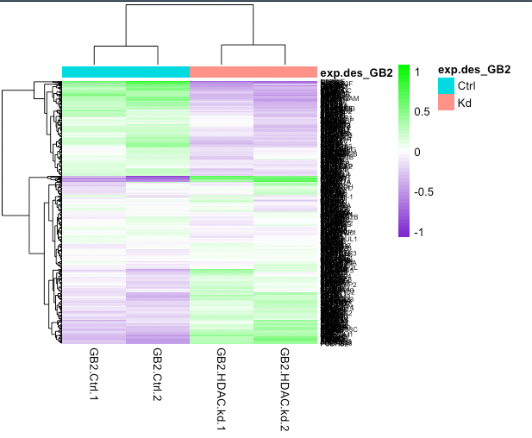
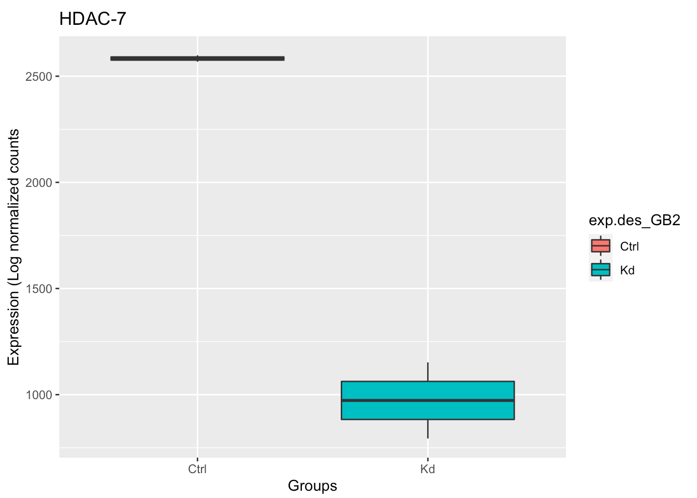
RNA Seq
GB2s FDR <0.01
Transcriptomic analysis for HDAC-7 siRNA knock down of our 1ry GSCs show 4963 genes differentially expressed between the HDAC-7 knock down and the siRNA negative control
KD HDAC-7 in our 1ry GSCs by siRNA
RNASeq
CT 1
CT 2
HDAC7 Kd 1
HDAC7 Kd 2
Notes:
Knowing the heterogeneity for the GBM tumors, we wanted to know if we can see the same significant results from our 1ry GSCs from patients
So, We knocked down HDAC-7 in our primary GSCs from patients, and we did RNAseq, and we found 6270 genes differentially expressed between siRNA KDAC7 KD vs non targeting siRNA control with the volcano plot showing up to 3-fold change in those differential gene expression

Slide 3
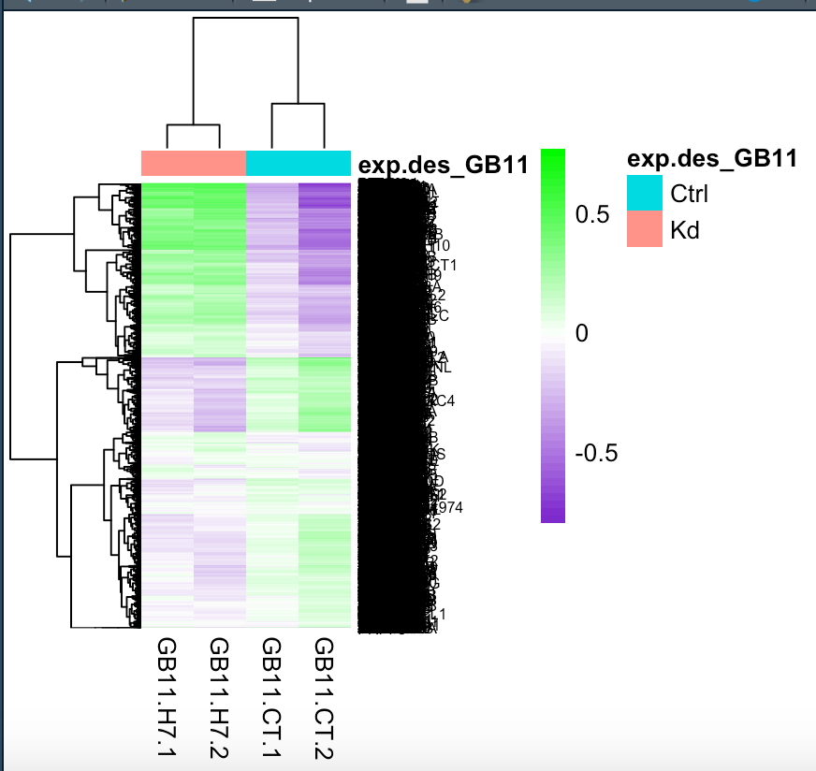
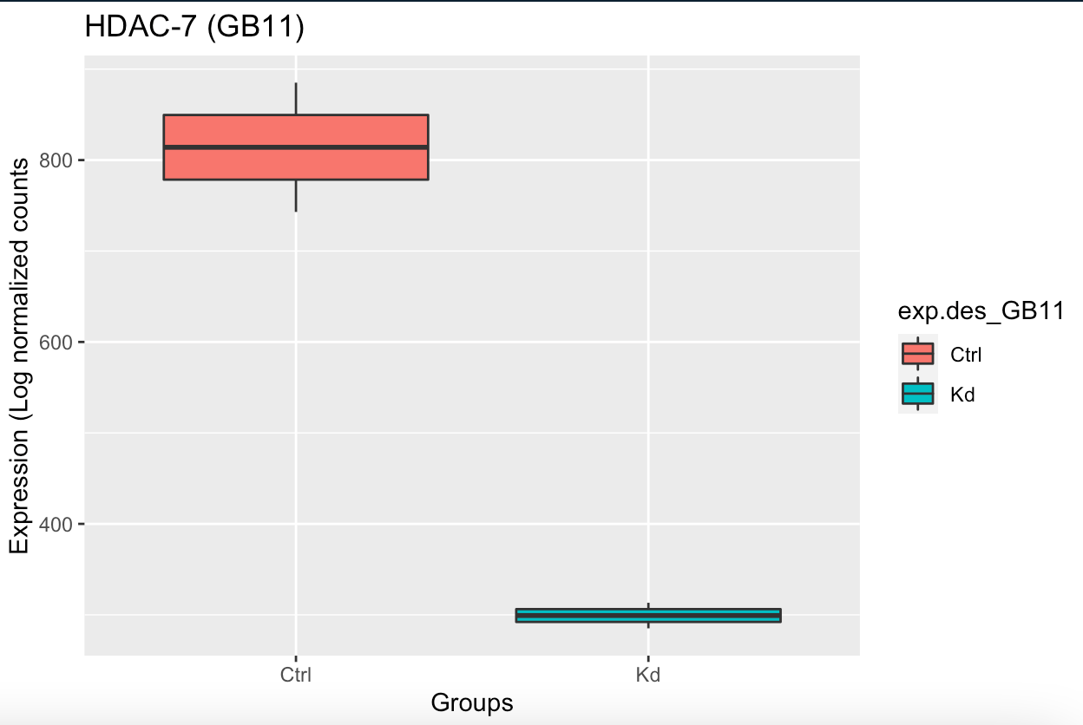
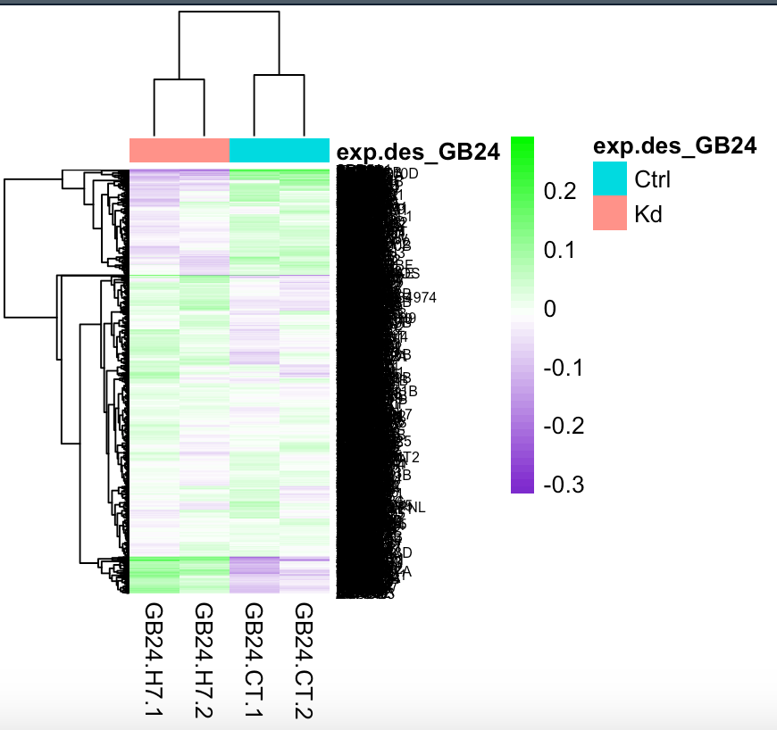
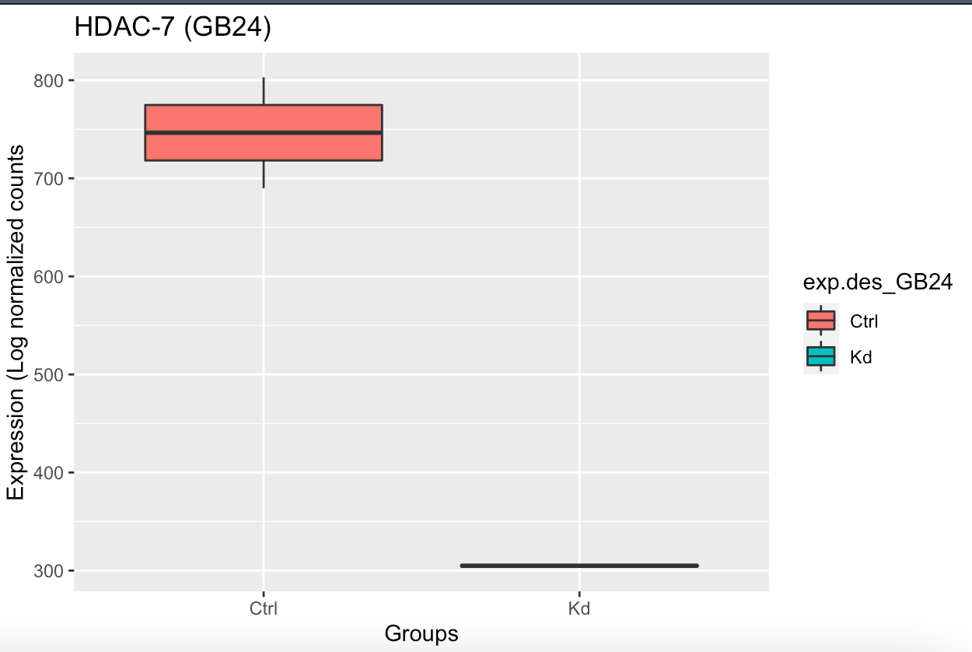
A. GSC1
B. GSC2
CT 1
CT 2
CT 1
CT 2
HDAC7 Kd 1
HDAC7 Kd 2
HDAC7 Kd 2
HDAC7 Kd 1
C. GSC3
CT1
CT2
HDAC7 Kd 1
HDAC7 Kd 2
Notes:
Knowing the heterogeneity for the GBM tumors, we wanted to know if we can see the same significant results from our 1ry GSCs from patients
So, We knocked down HDAC-7 in our primary GSCs from patients, and we did RNAseq, and we found 6270 genes differentially expressed between siRNA KDAC7 KD vs non targeting siRNA control with the volcano plot showing up to 3-fold change in those differential gene expression

Slide 4
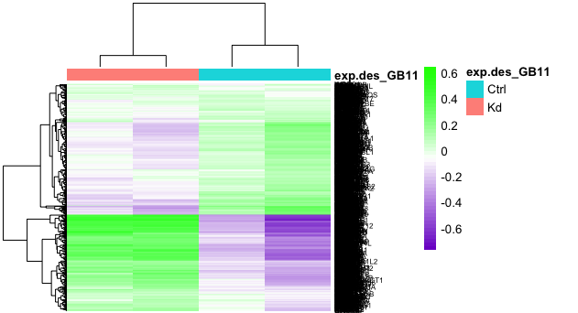
RNA Seq
GB11 FDR <0.05
Transcriptomic analysis for HDAC-7 siRNA knock down of our 1ry GSCs show 1870 genes differentially expressed between the HDAC-7 knock down and the siRNA negative control
KD HDAC-7 in our 1ry GSCs by siRNA
Experimental design: GBM
RNASeq
HDAC7 Kd 1
CT 1
CT 2
HDAC7 Kd 2
Notes:
Knowing the heterogeneity for the GBM tumors, we wanted to know if we can see the same significant results from our 1ry GSCs from patients
So, We knocked down HDAC-7 in our primary GSCs from patients, and we did RNAseq, and we found 6270 genes differentially expressed between siRNA KDAC7 KD vs non targeting siRNA control with the volcano plot showing up to 3-fold change in those differential gene expression

Slide 5
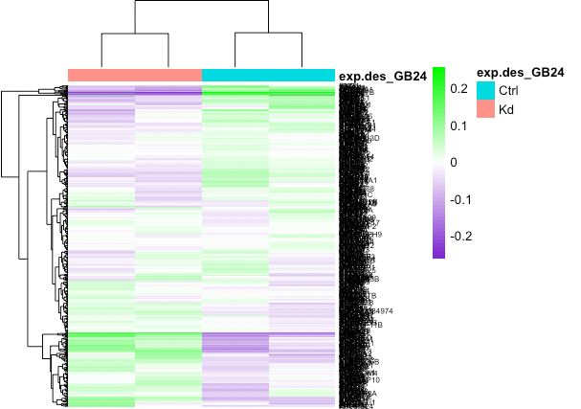
RNA Seq
GB24 FDR <0.05
Transcriptomic analysis for HDAC-7 siRNA knock down of our 1ry GSCs show 1342 genes differentially expressed between the HDAC-7 knock down and the siRNA negative control
KD HDAC-7 in our 1ry GSCs by siRNA
Experimental design: GBM
RNASeq
CT1
CT2
HDAC7 Kd 1
HDAC7 Kd 2
Notes:
Knowing the heterogeneity for the GBM tumors, we wanted to know if we can see the same significant results from our 1ry GSCs from patients
So, We knocked down HDAC-7 in our primary GSCs from patients, and we did RNAseq, and we found 6270 genes differentially expressed between siRNA KDAC7 KD vs non targeting siRNA control with the volcano plot showing up to 3-fold change in those differential gene expression

Slide 6
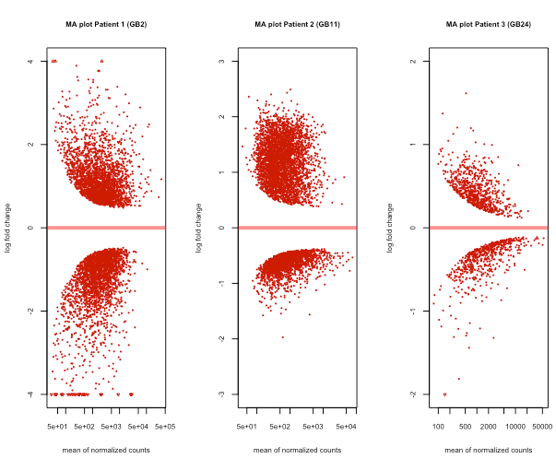

Slide 7
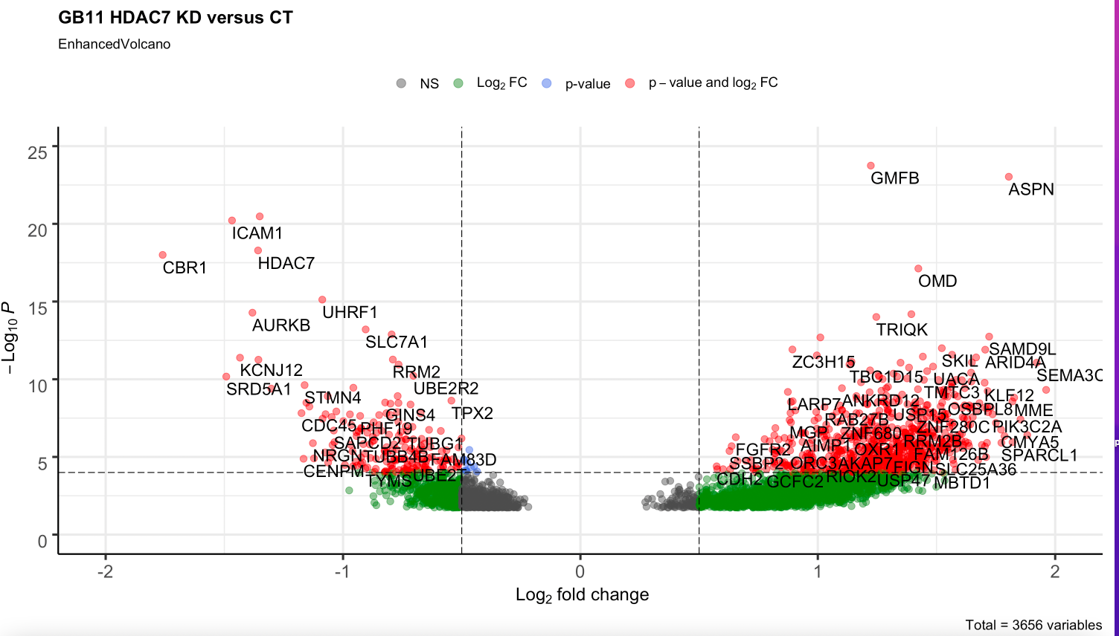
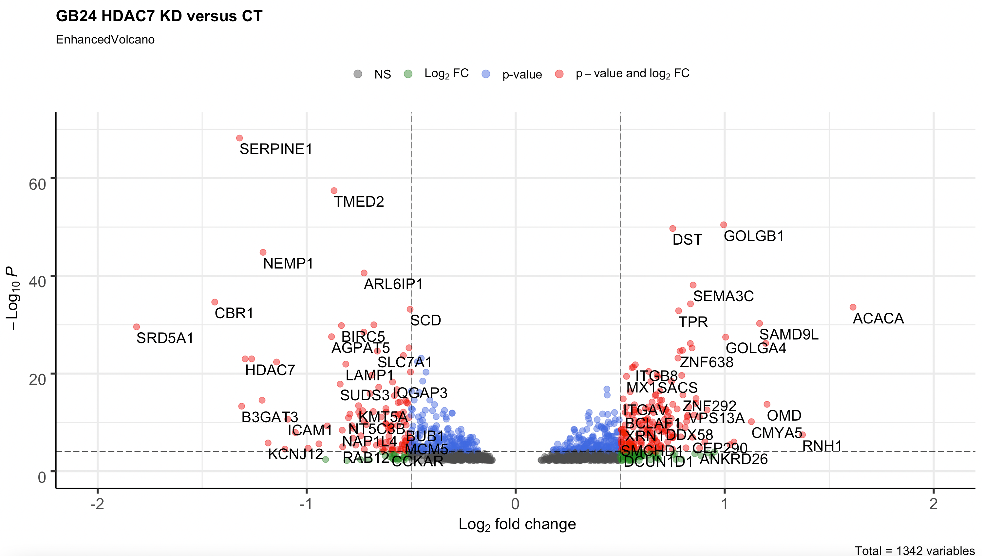
D. GSC1
E. GSC2
-Log₁₀ P
Log₂ fold change
F. GSC3
-Log₁₀ P
Log₂ fold change

Slide 8
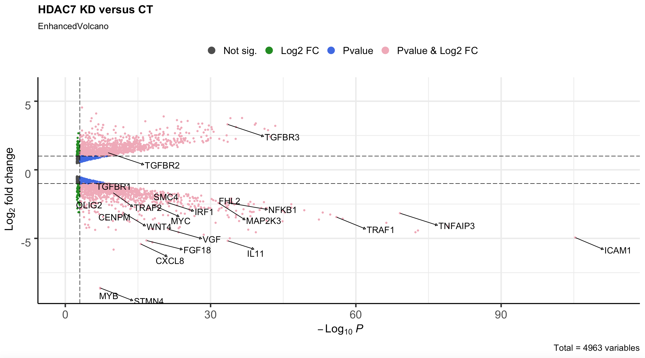
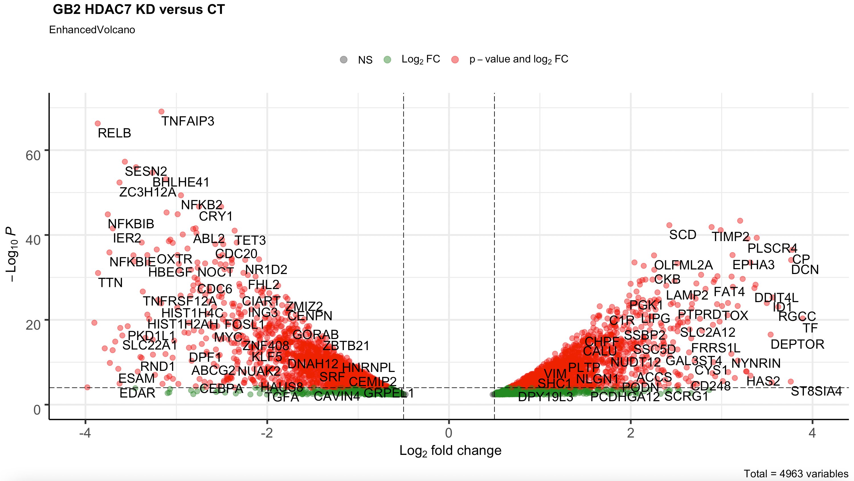
RNA Seq
Not sig.
Log₂ FC
Pvalue
Log₂ FC & Pvalue
GB2
Log₂ fold change
-Log₁₀ P

Slide 9
RNA Seq
3 replicates
GB11

Slide 10
RNA Seq
GB24

Slide 11
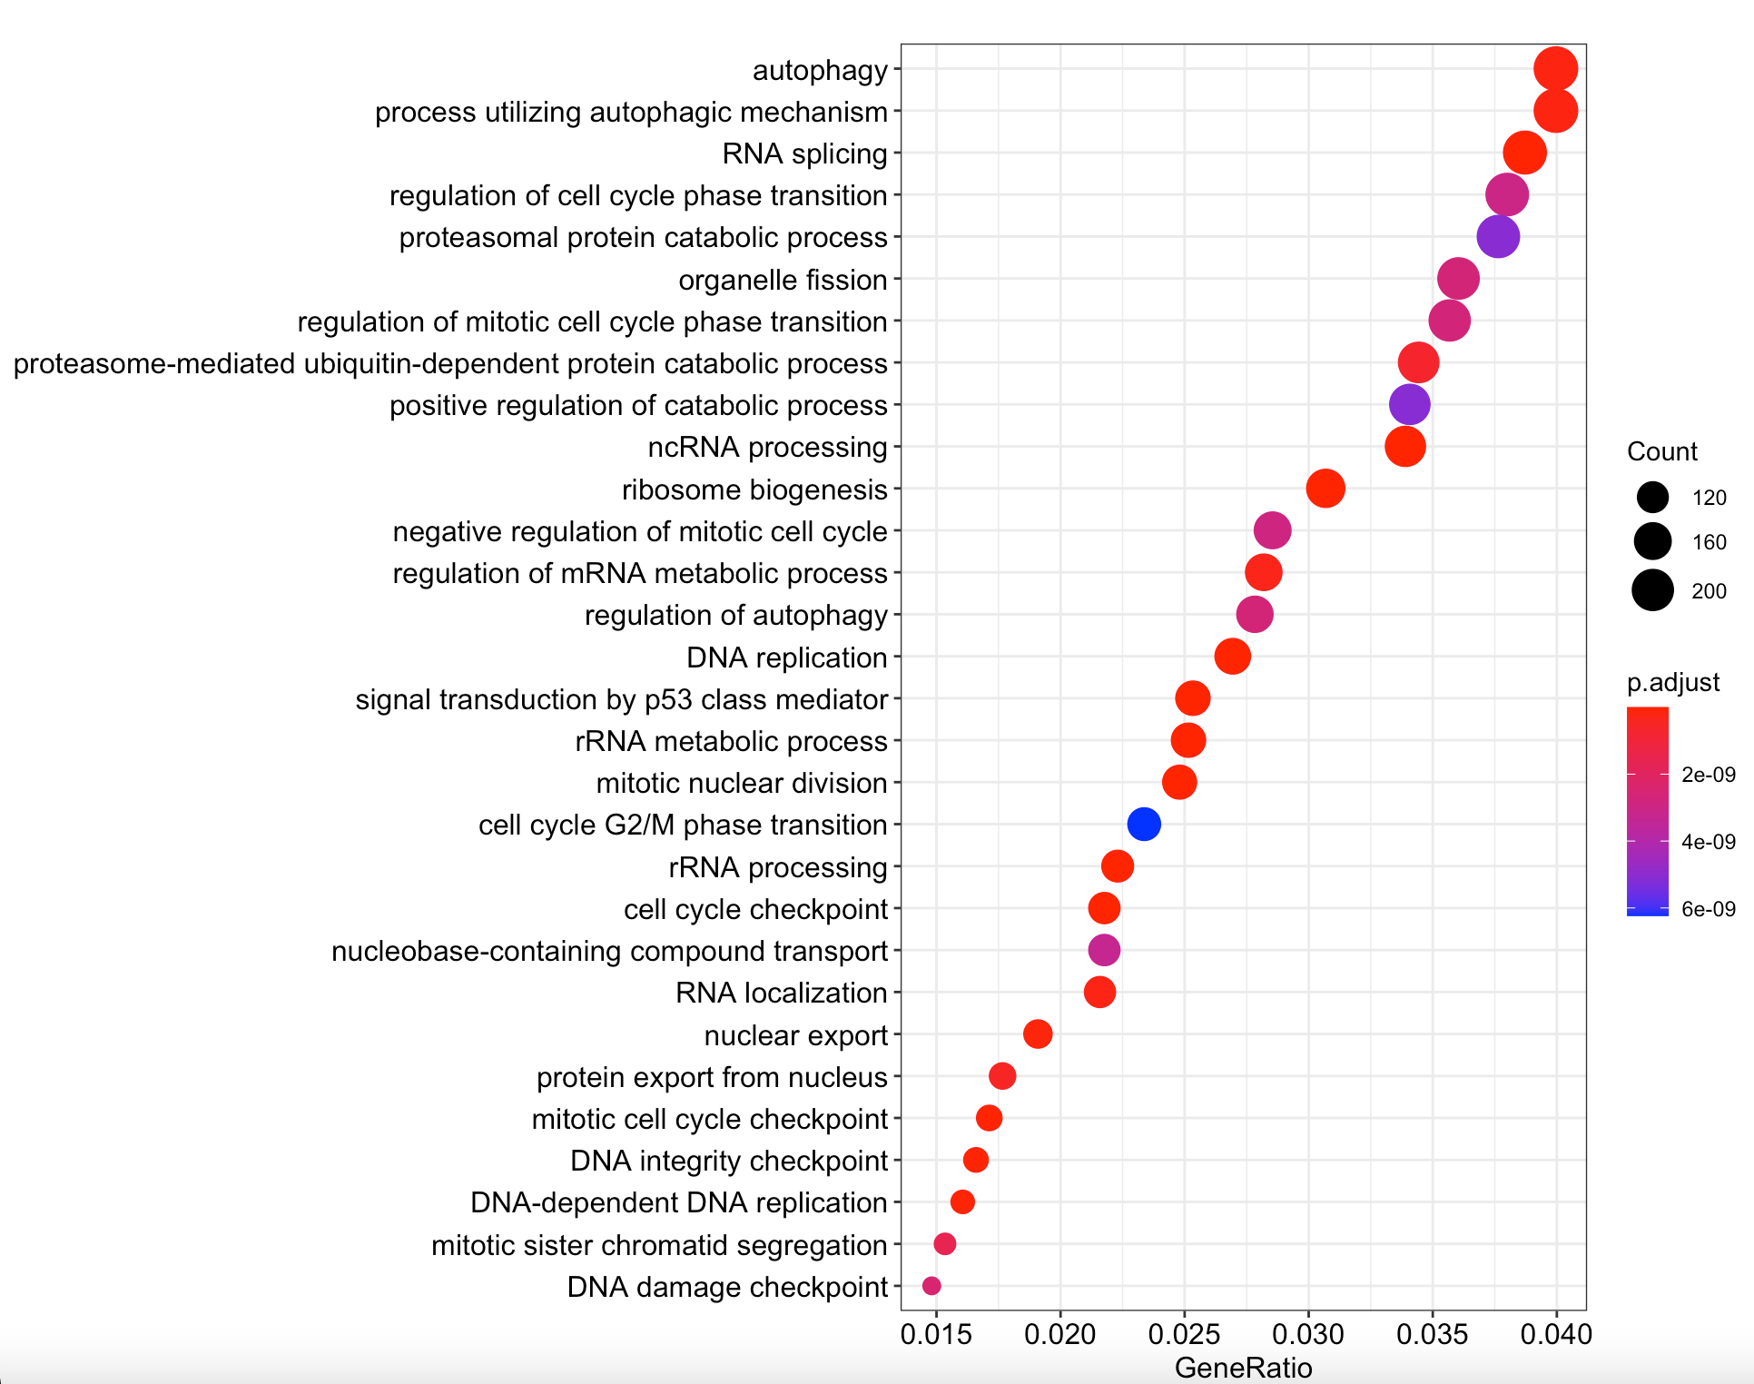
RNA Seq
Patient 1 (GB2)
GB2

Slide 12
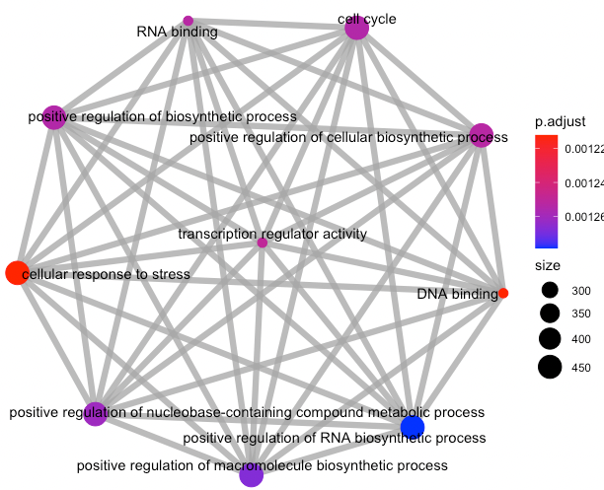
RNA Seq
Patient 1 (GB2)
GENE Ontology Enrichment

Slide 13
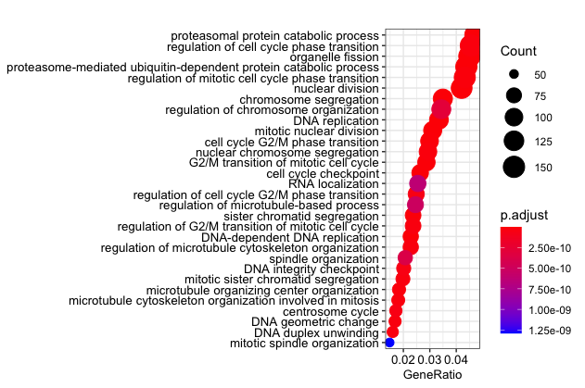
RNA Seq
Patient 2 (GB11)
GB11
GENE Ontology Enrichment

Slide 14
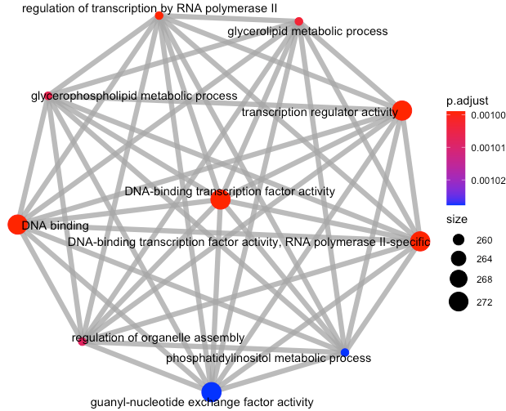
RNA Seq
Patient 2 (GB11)
GENE
Enrichment
Ontology

Slide 15
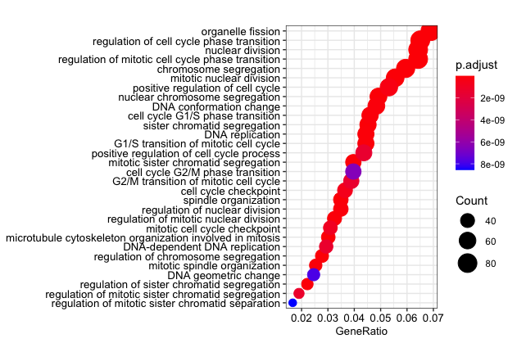
RNA Seq
Patient 3 (GB24)
GENE Ontology Enrichment

Slide 16
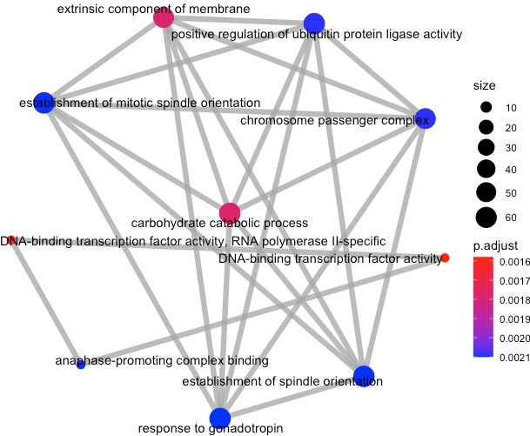
RNA Seq
Patient 3 (GB24)
GENE
Ontology
Enrichment

Slide 17
A. GSC1
B. GSC2
C. GSC3

Slide 18
A. GSC1
C. GSC3
B. GSC2

Slide 19
The gene enrichment for Biological processes between HDAC-7 siRNA and CT were for cell cycle processes and cell division
Patient 1 (GB2)
Notes:
Also, to confirm, we made gene enrichment through Gene ontology that confirmed the same enrichment towards cell cycle processes and cell division with even more powerful p values
There is also a tool to look into the protein domain enrichment and we did for the downregulated genes, and we saw enrichment towards important protein domains like the histone fold protein domain that can promote Chromatin Accessibility for Cell Type-Specific Master Transcription Factors
Also, it is well established that the Zn finger domains have roles in tumorigenesis, cancer progression and metastasis.

Slide 20
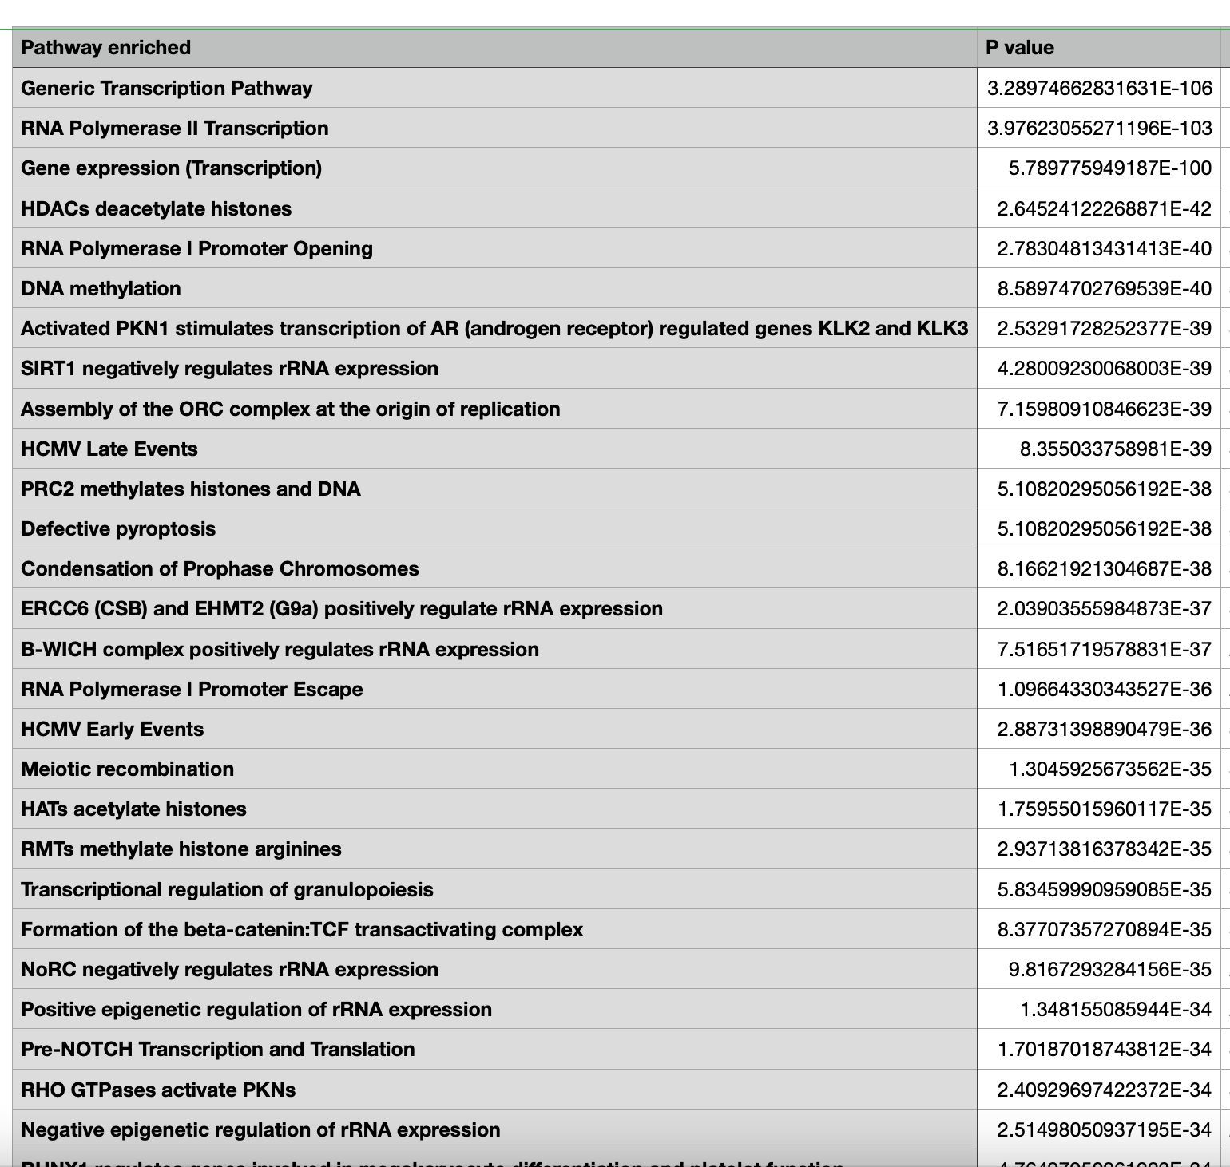
The Pathway enrichment after HDAC-7 knockdown were for cell cycle processes, cell division and genomic organization
Patient 1 (GB2)
KEGG database
BioGRID Interaction database
A. GSC1
Notes:
In addition, through the IntAct and BioGRID data bases that makes correlation analysis for the genetic, molecular and chemical interactions for the input genes, we saw that the genes that were downregulated by the knock down are interactors with crucial genes and oncogenes known to be implicated in cancers, for example MYC, tp53, and several growth factors , with high number of interactions.

Slide 21
The gene enrichment for Biological processes between HDAC-7 siRNA and CT were for cell cycle processes and cell division
Patient 1 (GB2)
IntAct Molecular Interaction database
BioGRID Interaction database
Notes:
In addition, through the IntAct and BioGRID data bases that makes correlation analysis for the genetic, molecular and chemical interactions for the input genes, we saw that the genes that were downregulated by the knock down are interactors with crucial genes and oncogenes known to be implicated in cancers, for example MYC, tp53, and several growth factors , with high number of interactions.

Slide 22
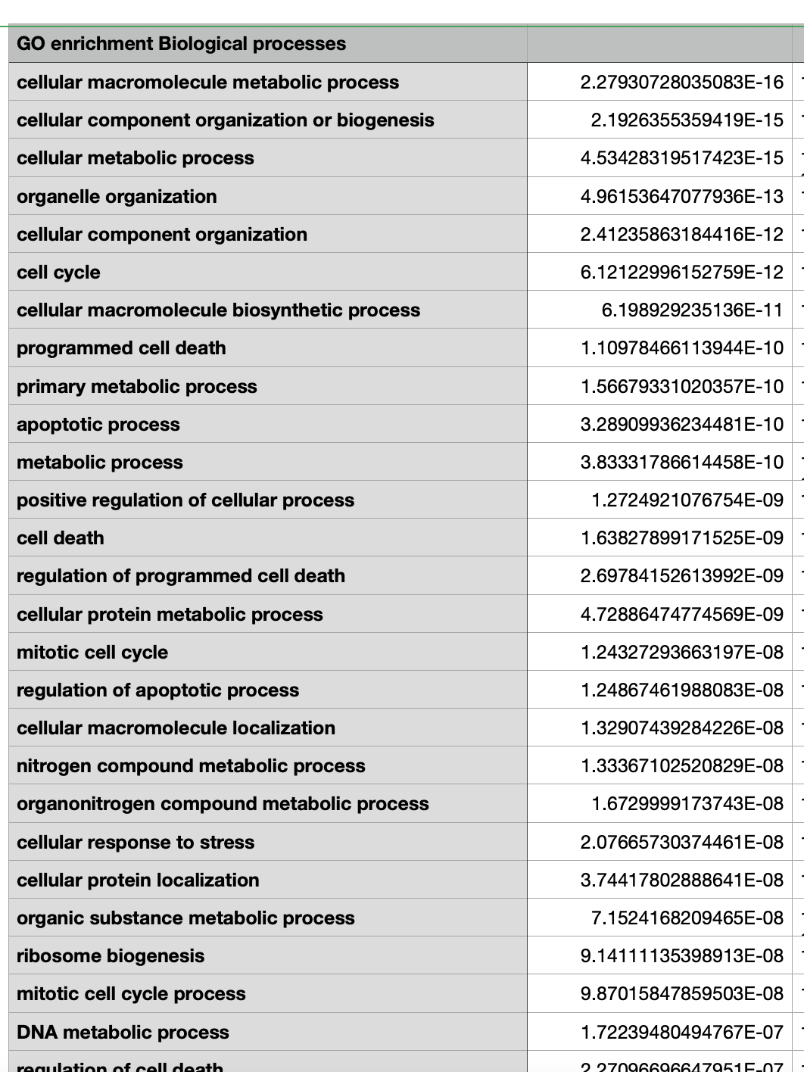
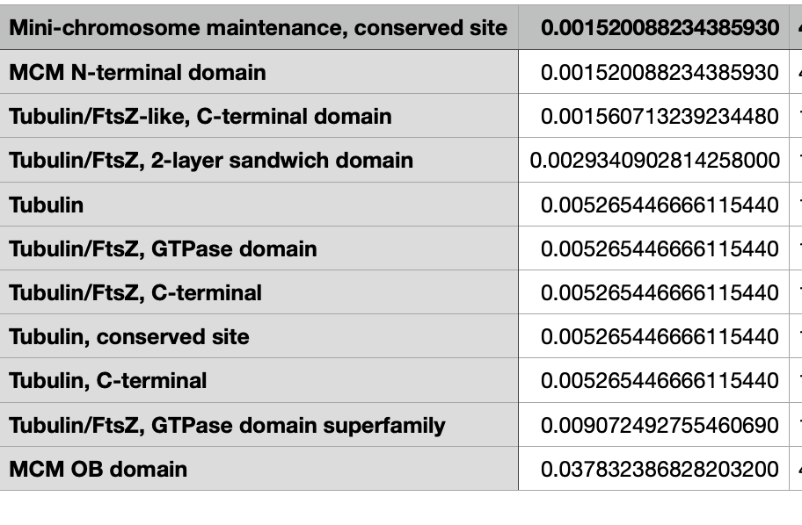
The Pathway enrichment after HDAC-7 knockdown were for cell cycle processes, cell division and genomic organization
Patient 2 (GB11)
Notes:
In addition, through the IntAct and BioGRID data bases that makes correlation analysis for the genetic, molecular and chemical interactions for the input genes, we saw that the genes that were downregulated by the knock down are interactors with crucial genes and oncogenes known to be implicated in cancers, for example MYC, tp53, and several growth factors , with high number of interactions.

Slide 23
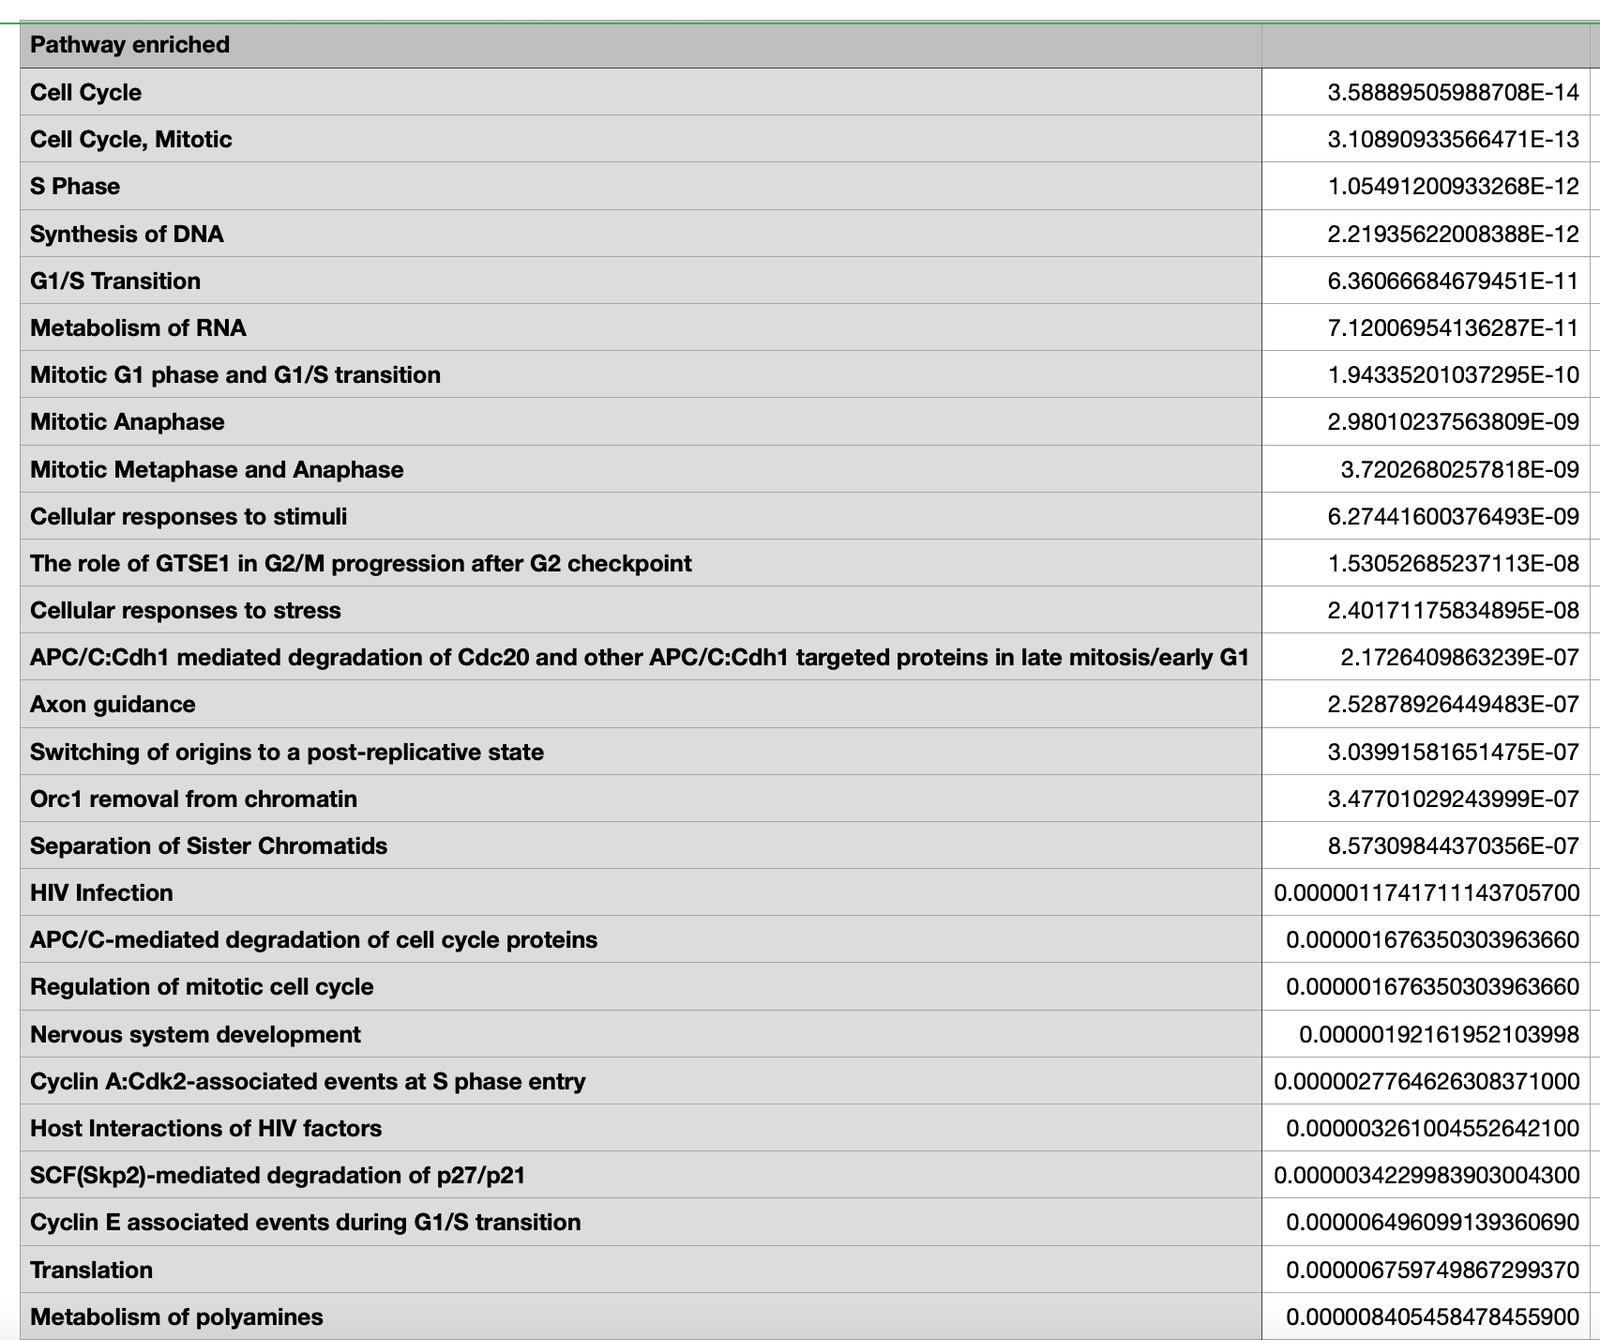
The Pathway enrichment after HDAC-7 knockdown were for cell cycle processes, cell division and genomic organization
Patient 2 (GB11)
B. GSC2
IntAct Molecular Interaction database
BioGRID Interaction database
Notes:
In addition, through the IntAct and BioGRID data bases that makes correlation analysis for the genetic, molecular and chemical interactions for the input genes, we saw that the genes that were downregulated by the knock down are interactors with crucial genes and oncogenes known to be implicated in cancers, for example MYC, tp53, and several growth factors , with high number of interactions.

Slide 24
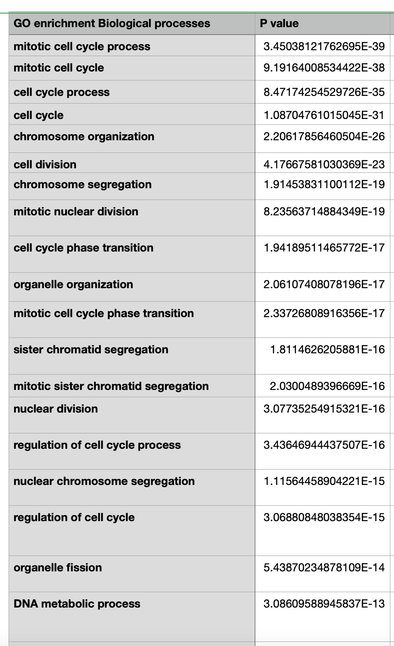
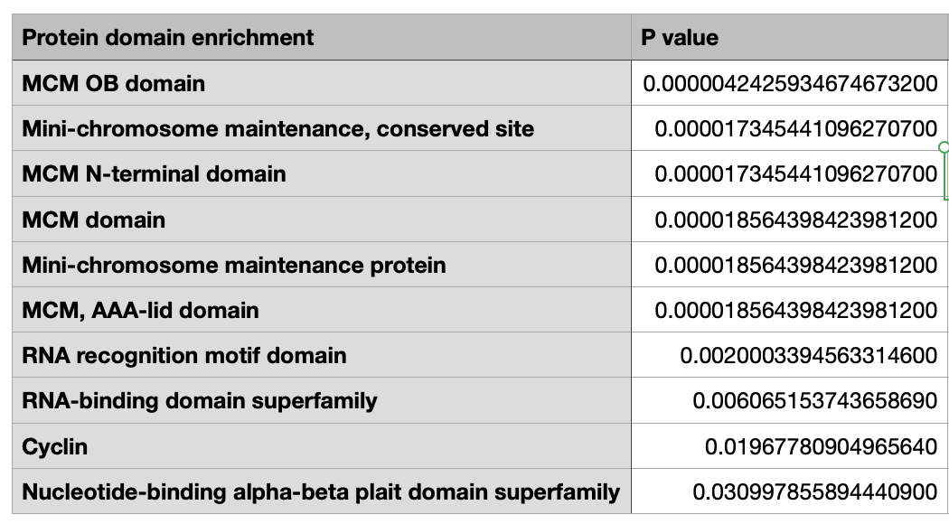
The gene enrichment for Biological processes between HDAC-7 siRNA and CT were for cell cycle processes and cell division
Patient 3 (GB24)
Notes:
In addition, through the IntAct and BioGRID data bases that makes correlation analysis for the genetic, molecular and chemical interactions for the input genes, we saw that the genes that were downregulated by the knock down are interactors with crucial genes and oncogenes known to be implicated in cancers, for example MYC, tp53, and several growth factors , with high number of interactions.

Slide 25
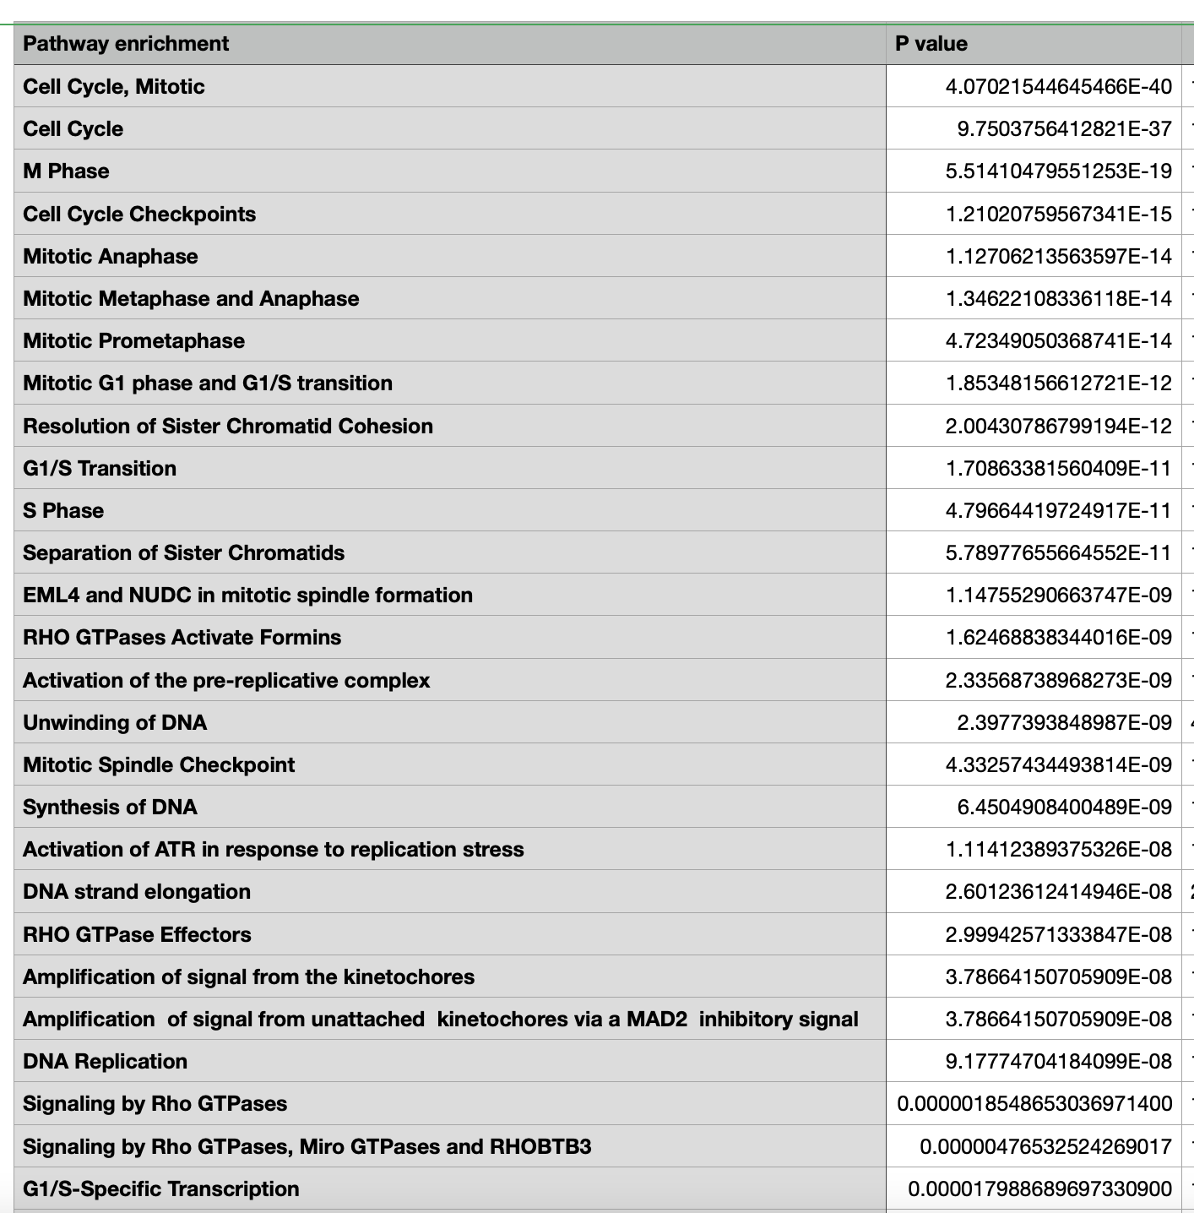
The gene enrichment for Biological processes between HDAC-7 siRNA and CT were for cell cycle processes and cell division
Patient 3 (GB24)
C. GSC3
KEGG database
BioGRID Interaction database
Notes:
In addition, through the IntAct and BioGRID data bases that makes correlation analysis for the genetic, molecular and chemical interactions for the input genes, we saw that the genes that were downregulated by the knock down are interactors with crucial genes and oncogenes known to be implicated in cancers, for example MYC, tp53, and several growth factors , with high number of interactions.

Slide 26
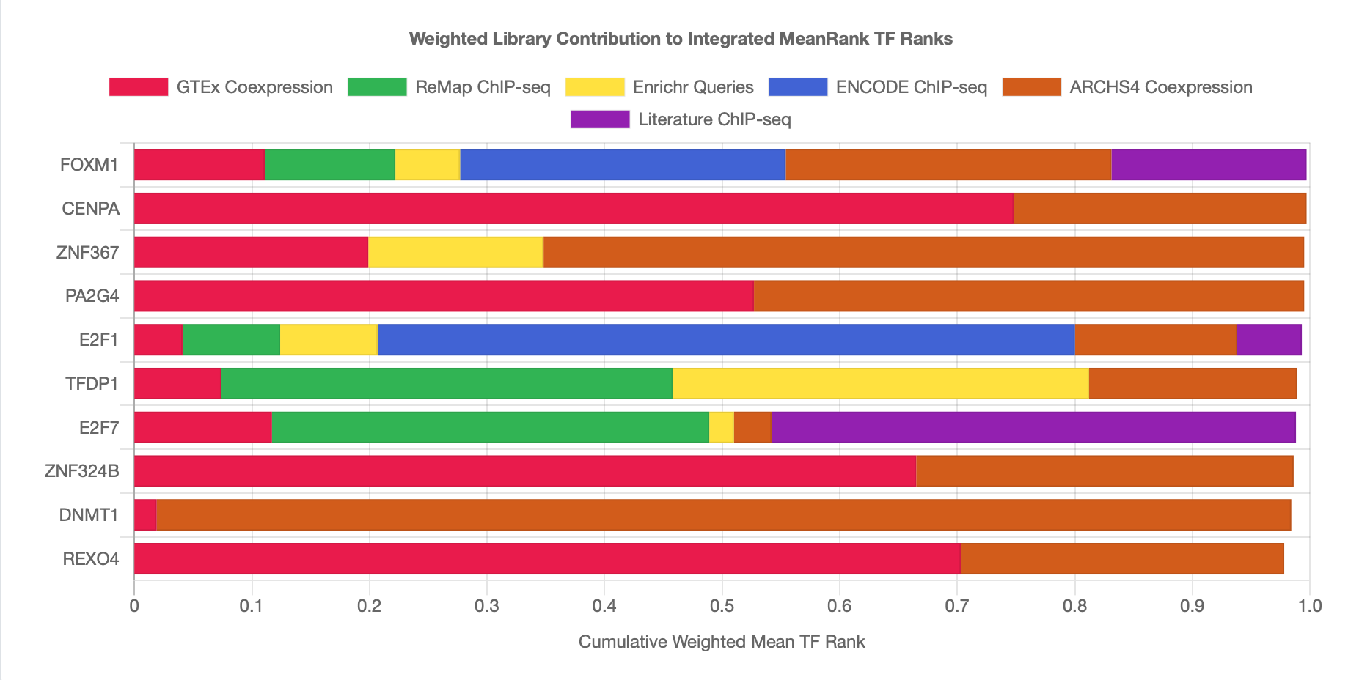
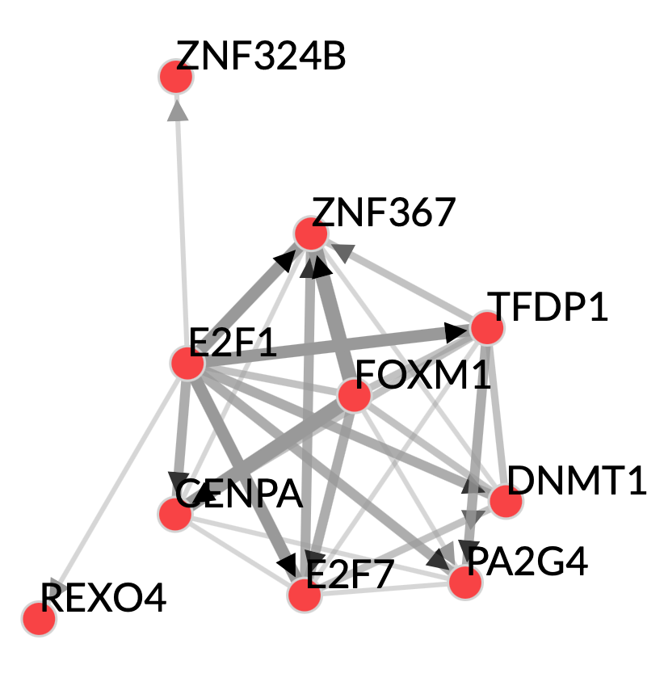
The TF enrichment shows FOXM1 and CENPA TF was a top hit with 433 overlapping genes with genes that were down regulated by the knockdown
GB2
Notes:
FOXM1 is highly expressed in various types of human malignancies, such as glioblastoma, lung cancer, , prostate cancer, basal cell carcinomas, hepatocellular carcinoma, pancreatic cancer, gastric cancer and squamous cell carcinoma

Slide 27
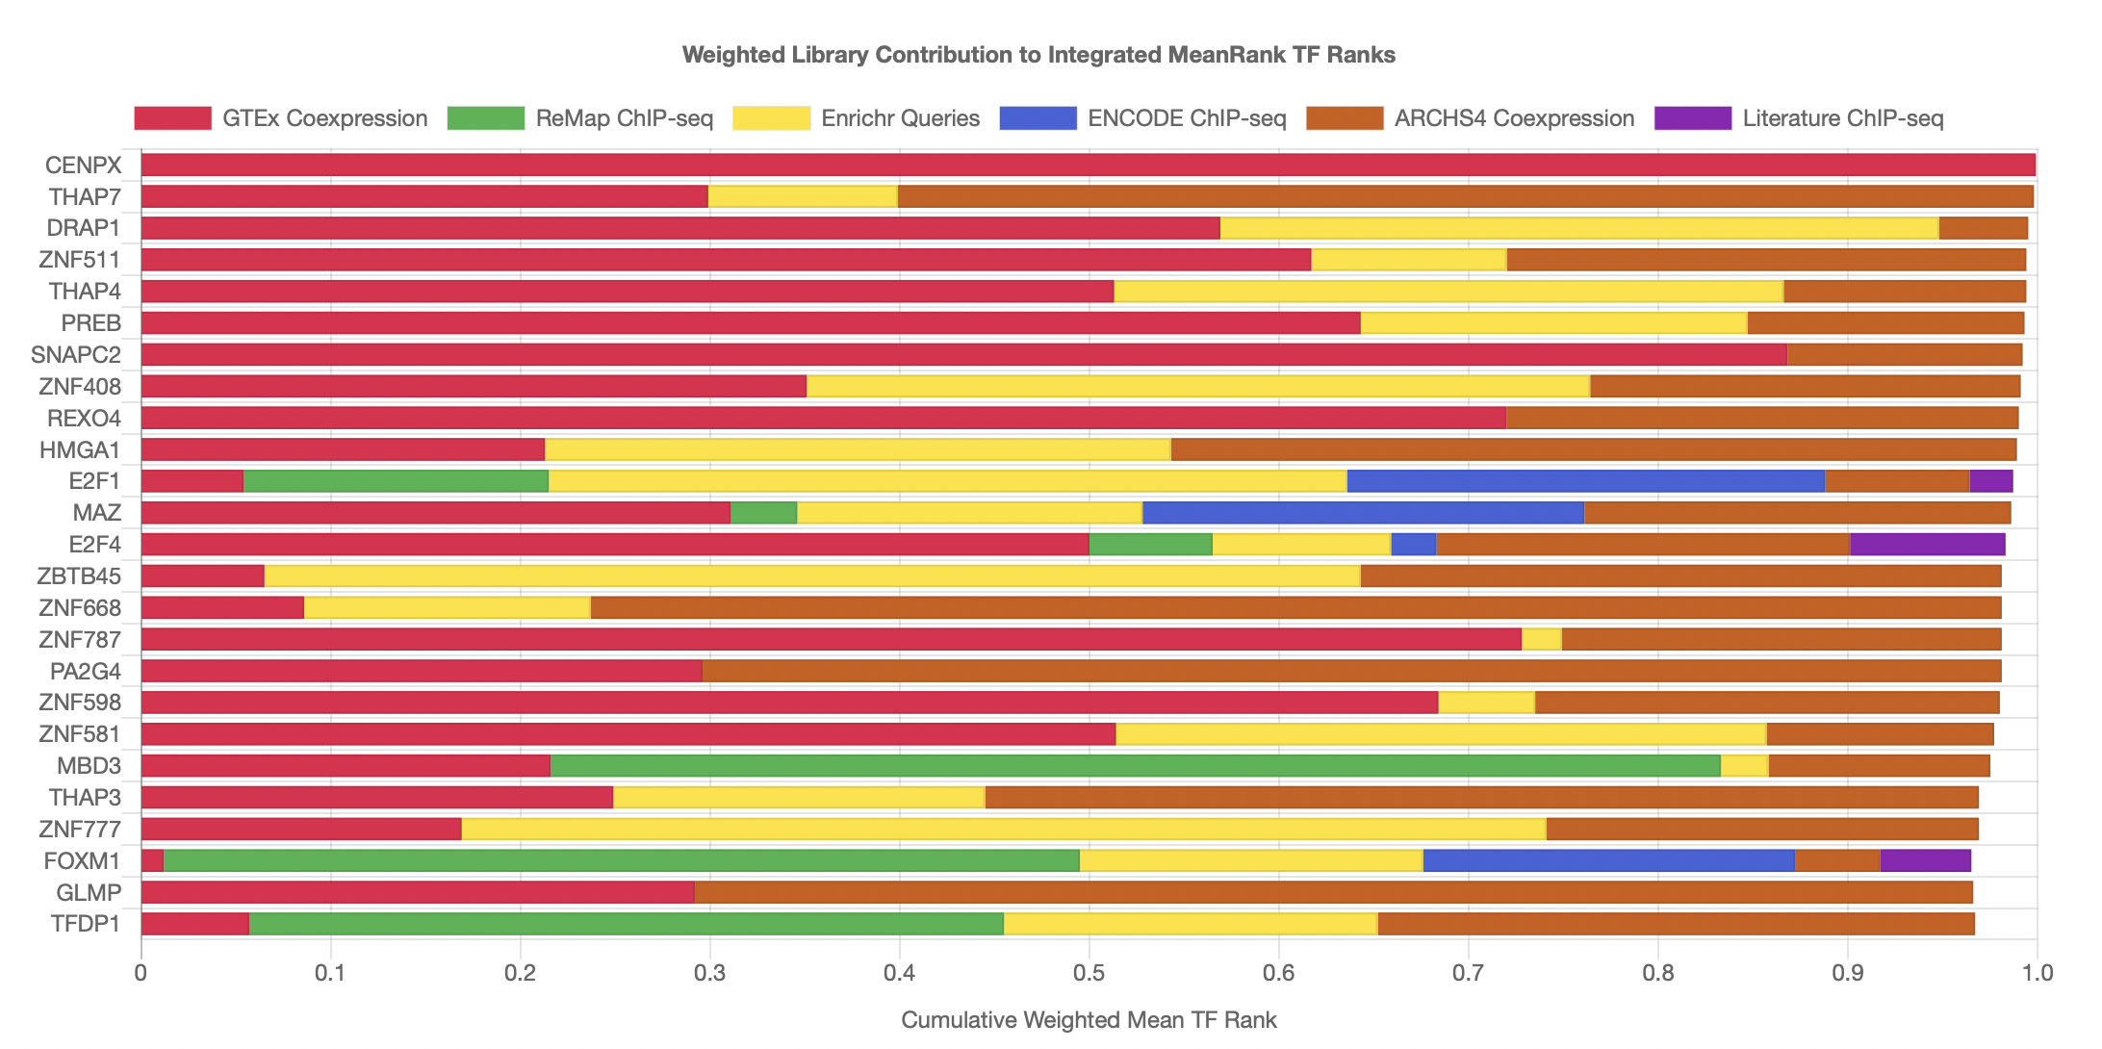
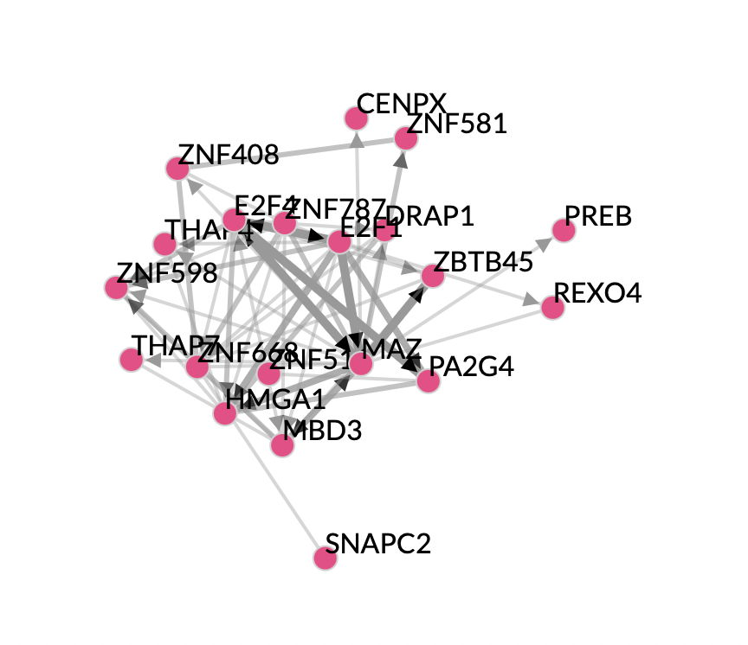
The TF enrichment for genes down regulated by the knockdown
GB11
Notes:
https://maayanlab.cloud/chea3/#top

Slide 28
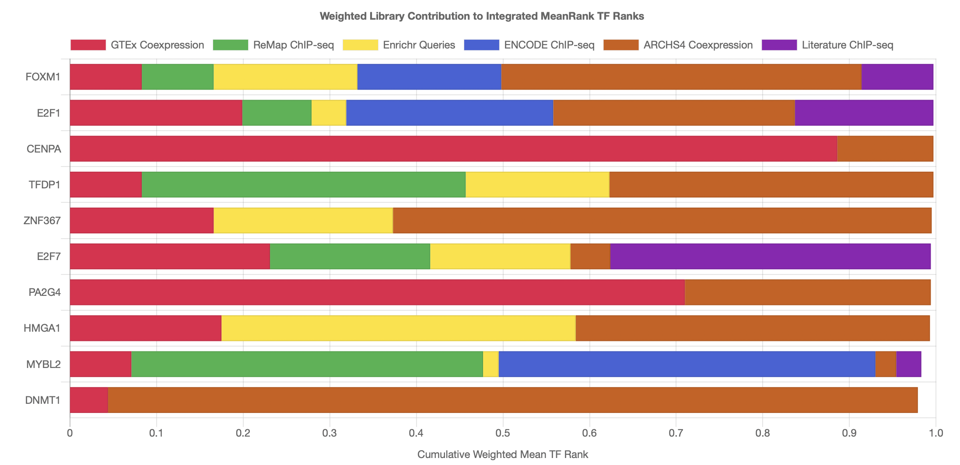
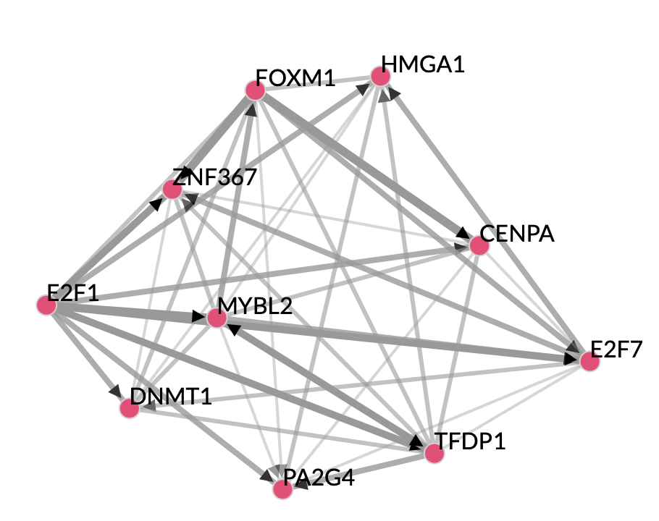
The TF enrichment for genes down regulated by the knockdown
GB24
Notes:
https://maayanlab.cloud/chea3/#top

Slide 29
D. GSC1
E. GSC2
F. GSC3

Slide 30
RNA Seq
The genes they were differentially expressed between the HDAC-7 knock down and the siRNA control are highly expressed in the embryonic stem cells and the embryonic carcinoma
GB2
Webtool: StemChecker
Notes:
Additionally, we checked whether the genes that were downregulated by the HDAC-7 knockdown have role in stemness. We found 653 genes that were downregulated from KD that have a significant role in regulating stemness, with those genes closer to the embryonic stem cells’ and embryonal carcinoma’s phenotype
The checkerboard table shows the occurrence of each individual gene from our data and its occurrence across different stemness signature data bases.
These databases were constructed from TF target genes, expression profiles, RNAi screens or from literature or computationally predicted . (those are the top genes)

Slide 31
Notes:
Additionally, we checked whether the genes that were downregulated by the HDAC-7 knockdown have role in stemness. We found 653 genes that were downregulated from KD that have a significant role in regulating stemness, with those genes closer to the embryonic stem cells’ and embryonal carcinoma’s phenotype
The checkerboard table shows the occurrence of each individual gene from our data and its occurrence across different stemness signature data bases.
These databases were constructed from TF target genes, expression profiles, RNAi screens or from literature or computationally predicted . (those are the top genes)

Slide 32
RNA Seq
The genes they were differentially expressed between the HDAC-7 knock down and the siRNA control are highly expressed in the embryonic stem cells and the embryonic carcinoma
GB11: 2 replicates
Patient 2 (GB11)
Notes:
Additionally, we checked whether the genes that were downregulated by the HDAC-7 knockdown have role in stemness. We found 653 genes that were downregulated from KD that have a significant role in regulating stemness, with those genes closer to the embryonic stem cells’ and embryonal carcinoma’s phenotype
The checkerboard table shows the occurrence of each individual gene from our data and its occurrence across different stemness signature data bases.
These databases were constructed from TF target genes, expression profiles, RNAi screens or from literature or computationally predicted . (those are the top genes)

Slide 33
RNA Seq
The genes they were differentially expressed between the HDAC-7 knock down and the siRNA control are highly expressed in the embryonic stem cells and the embryonic carcinoma
GB24
Notes:
Additionally, we checked whether the genes that were downregulated by the HDAC-7 knockdown have role in stemness. We found 653 genes that were downregulated from KD that have a significant role in regulating stemness, with those genes closer to the embryonic stem cells’ and embryonal carcinoma’s phenotype
The checkerboard table shows the occurrence of each individual gene from our data and its occurrence across different stemness signature data bases.
These databases were constructed from TF target genes, expression profiles, RNAi screens or from literature or computationally predicted . (those are the top genes)

Slide 34
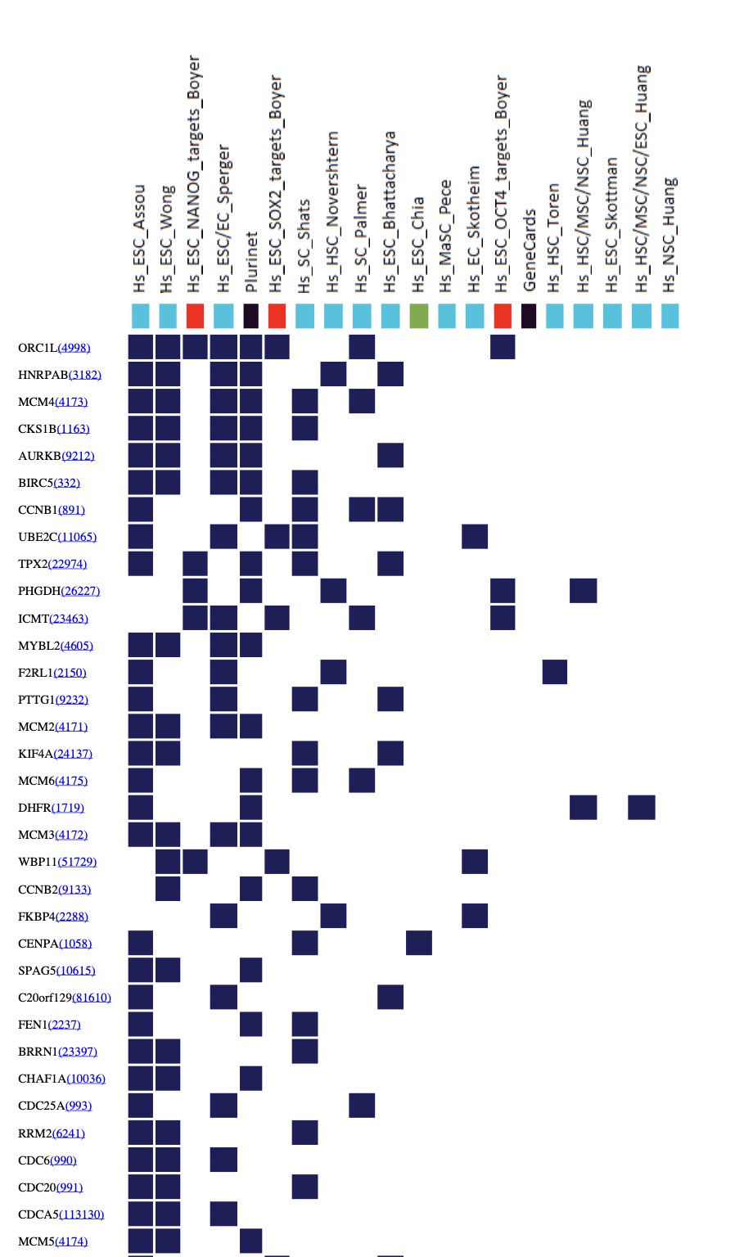
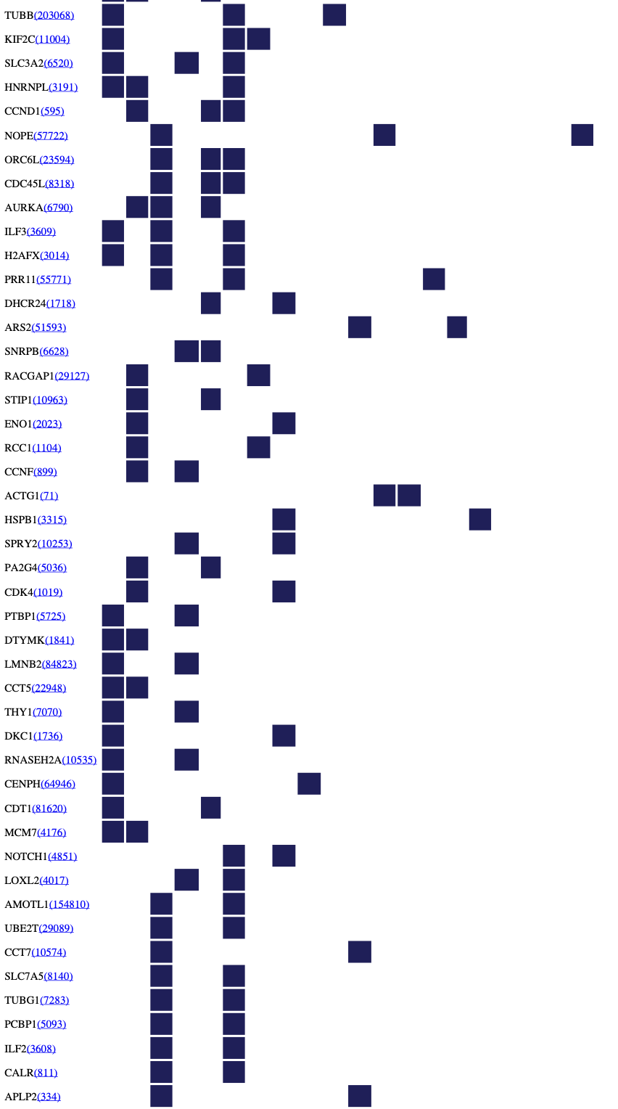
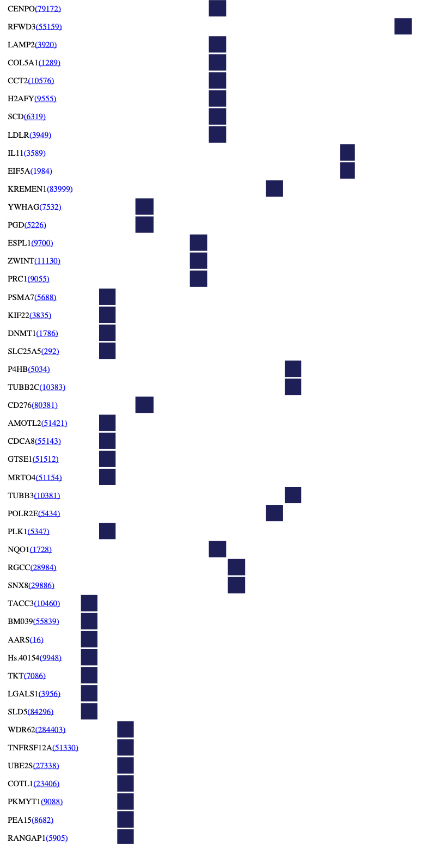
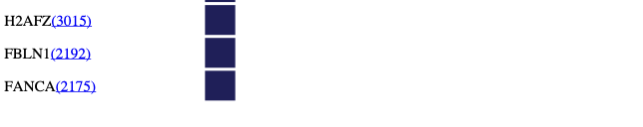

Slide 36
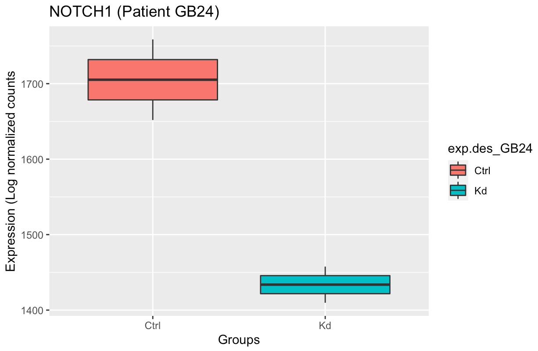
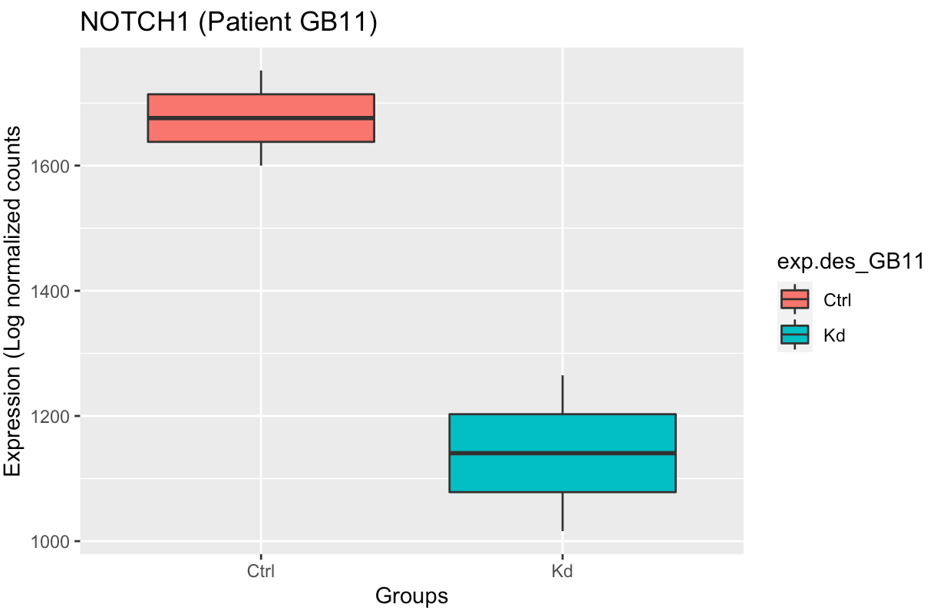
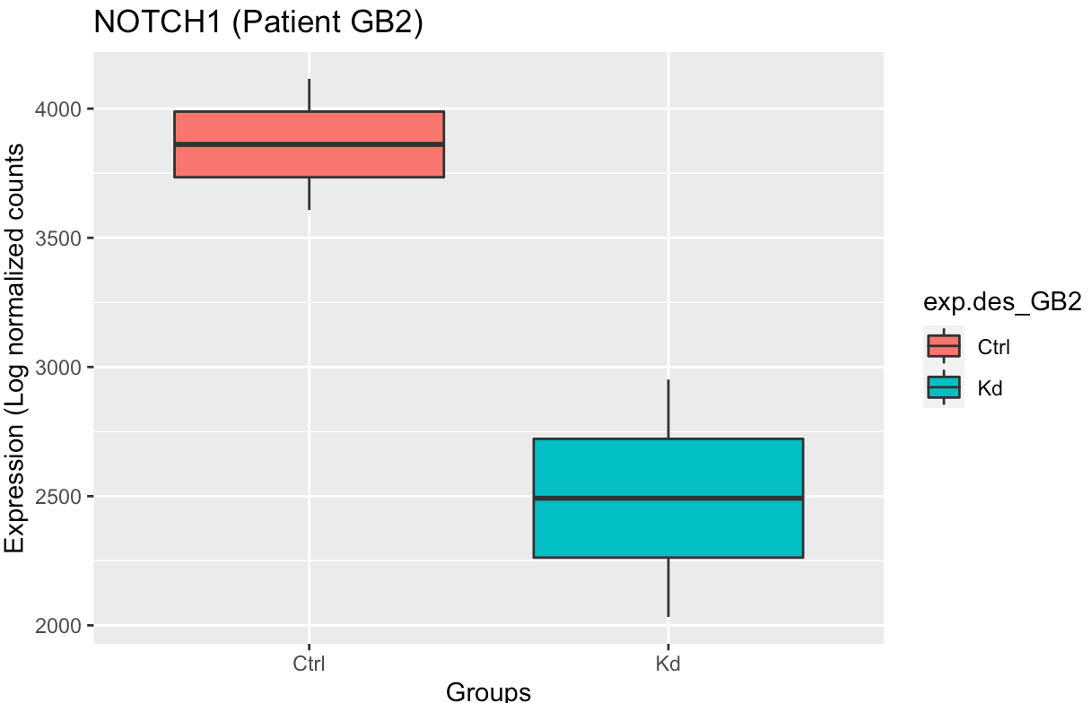
Notch1

Slide 37
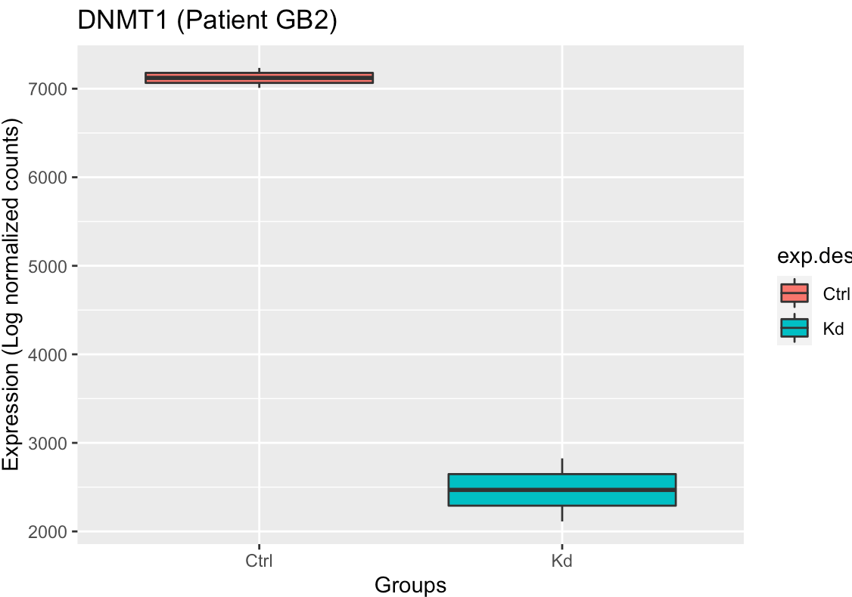
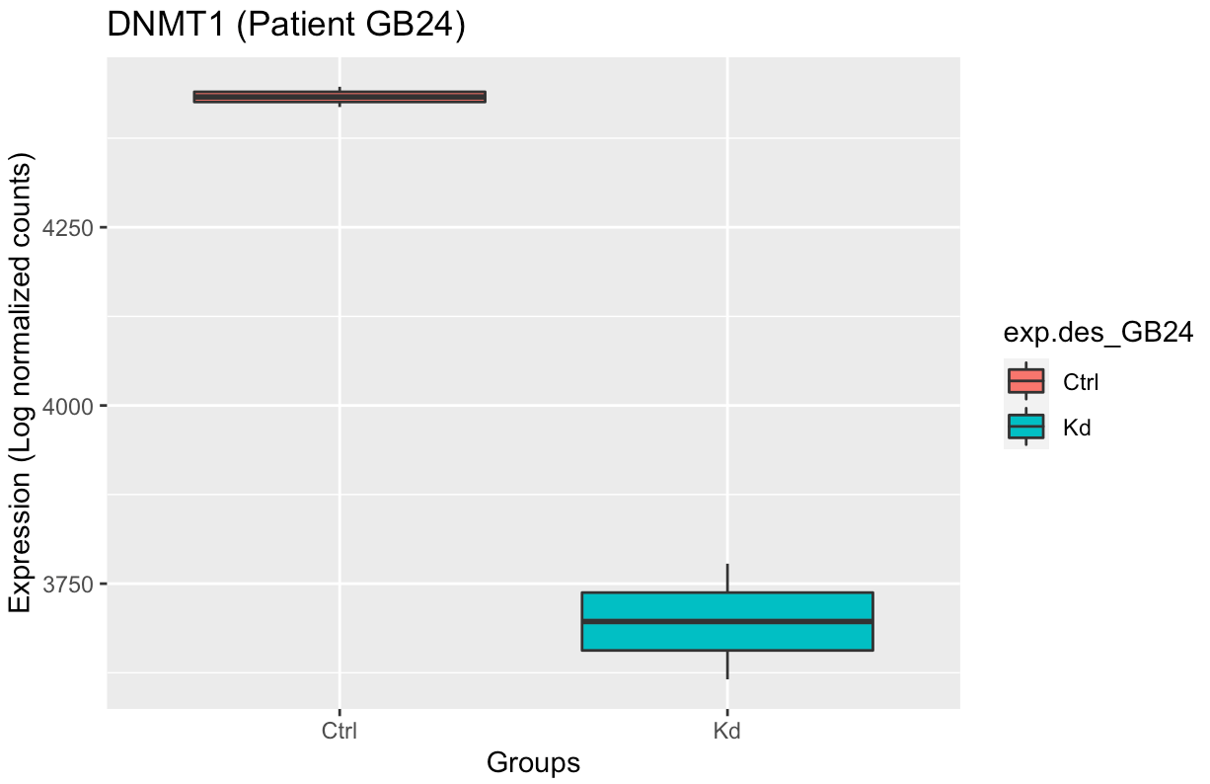
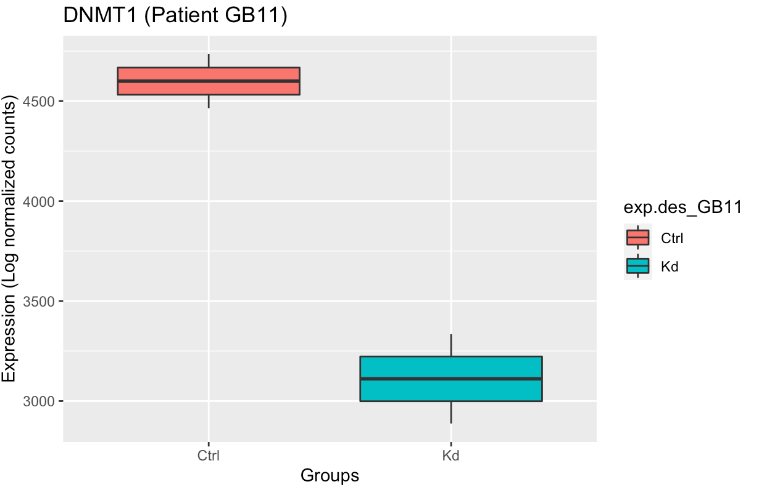
DNMT1

Slide 38
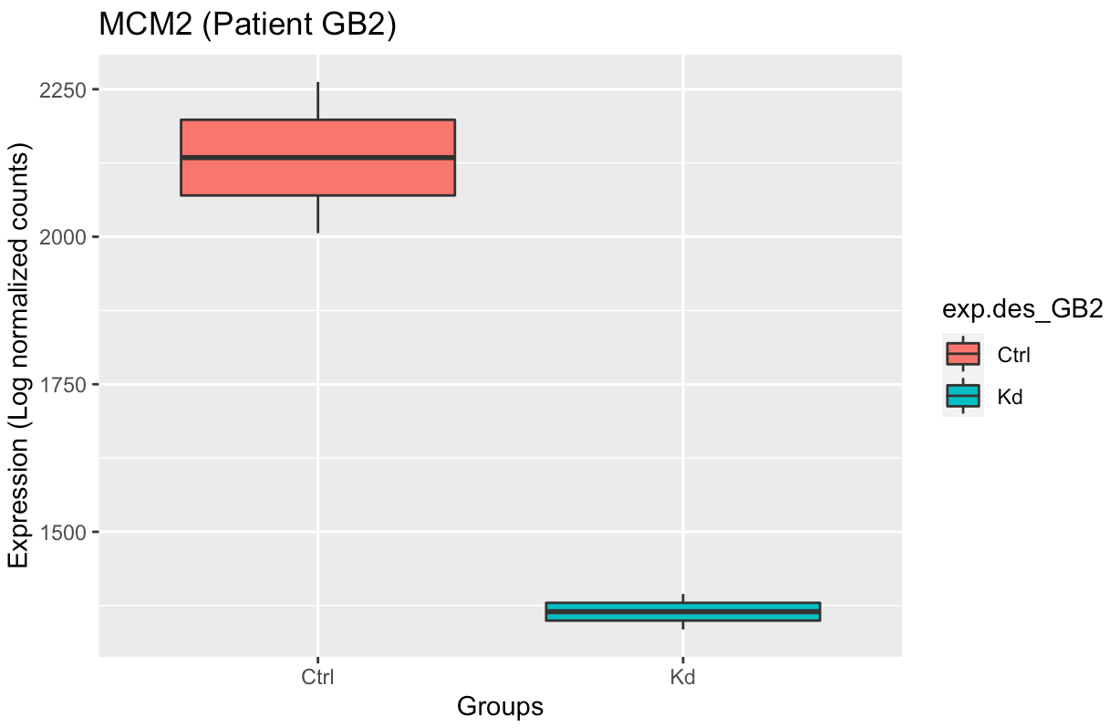
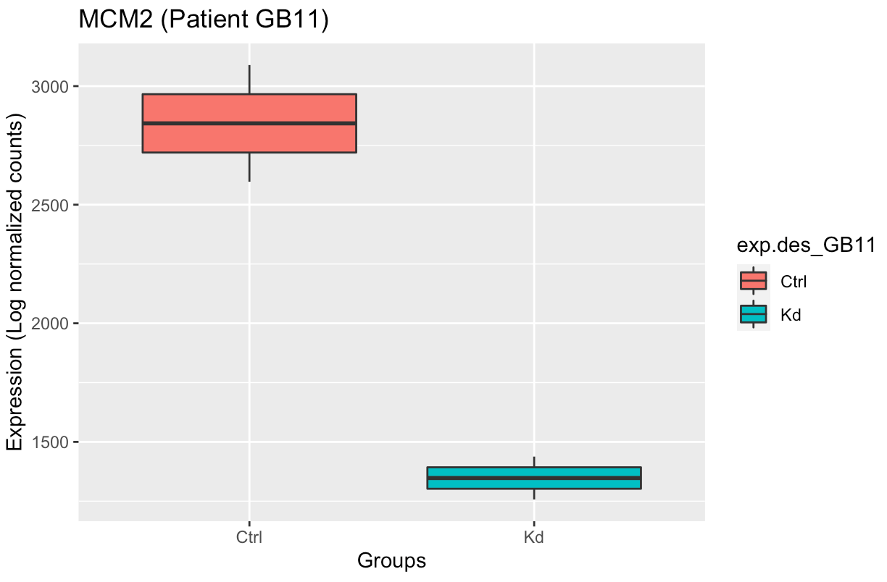
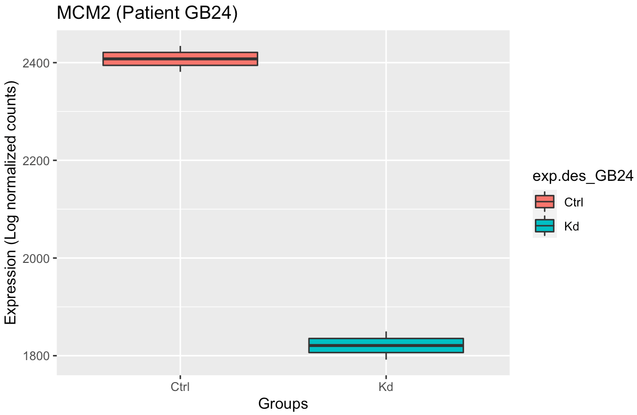
MCM2

Slide 39
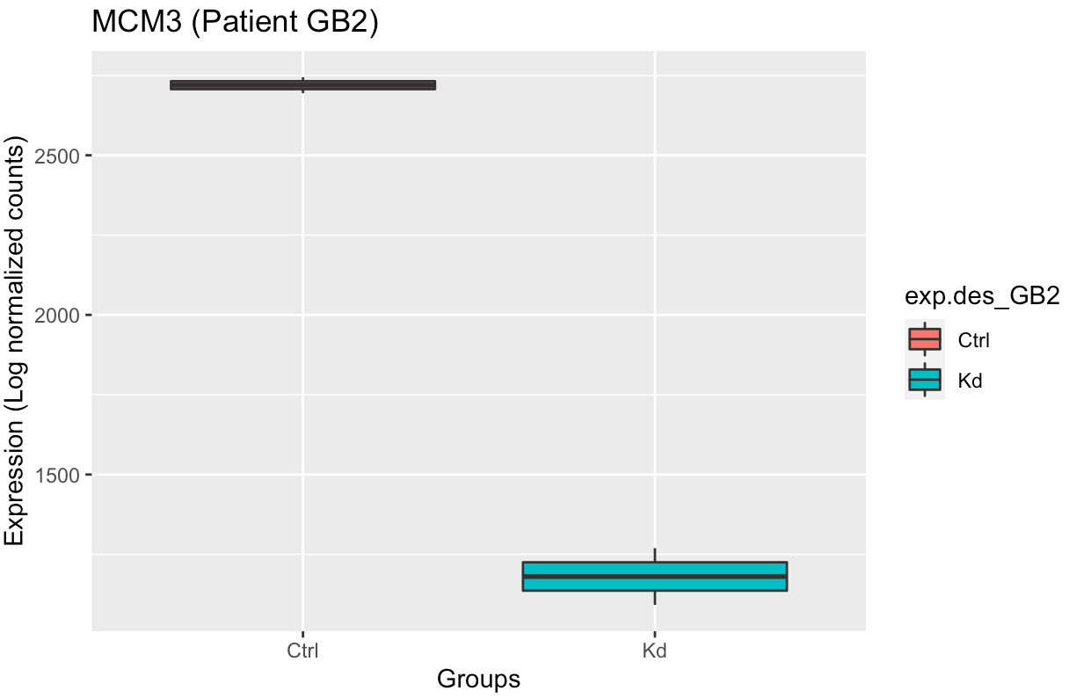
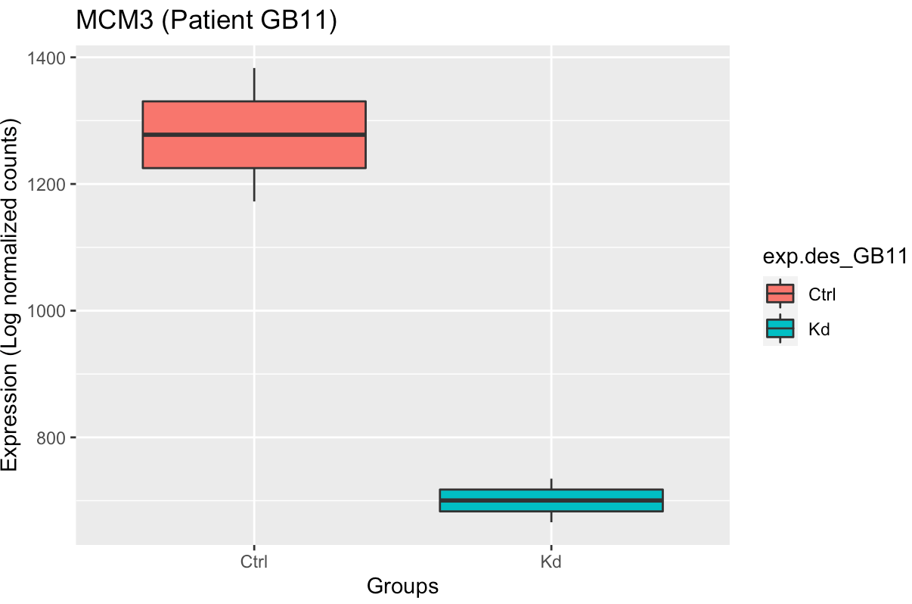
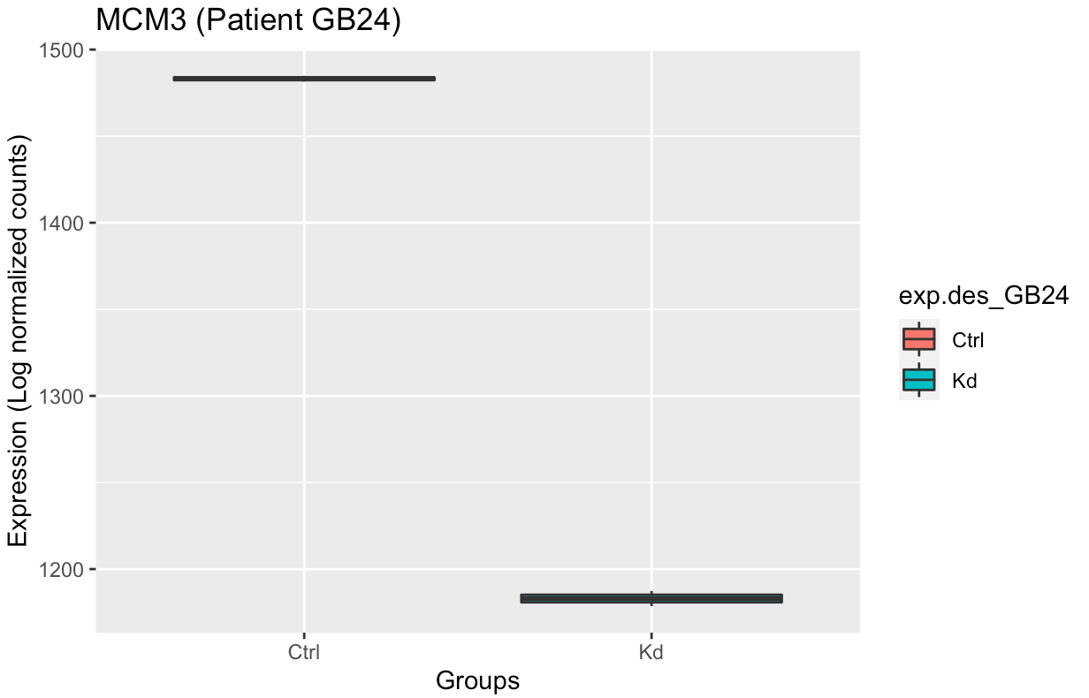
MCM3

Slide 40
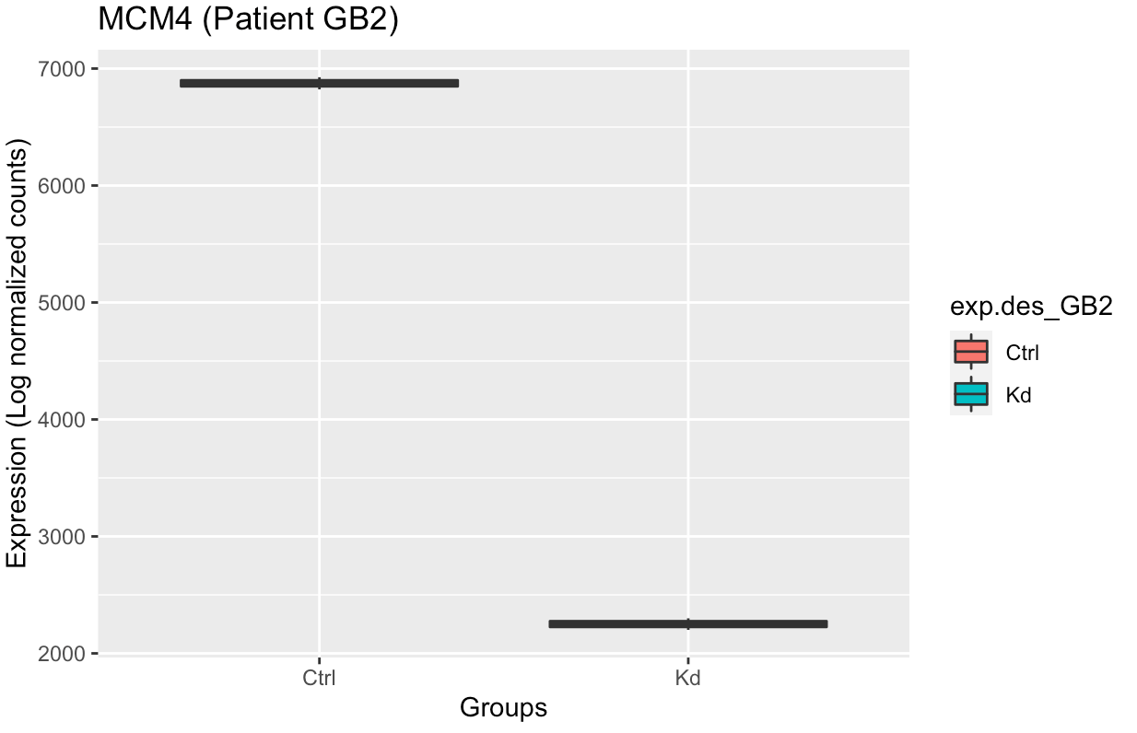
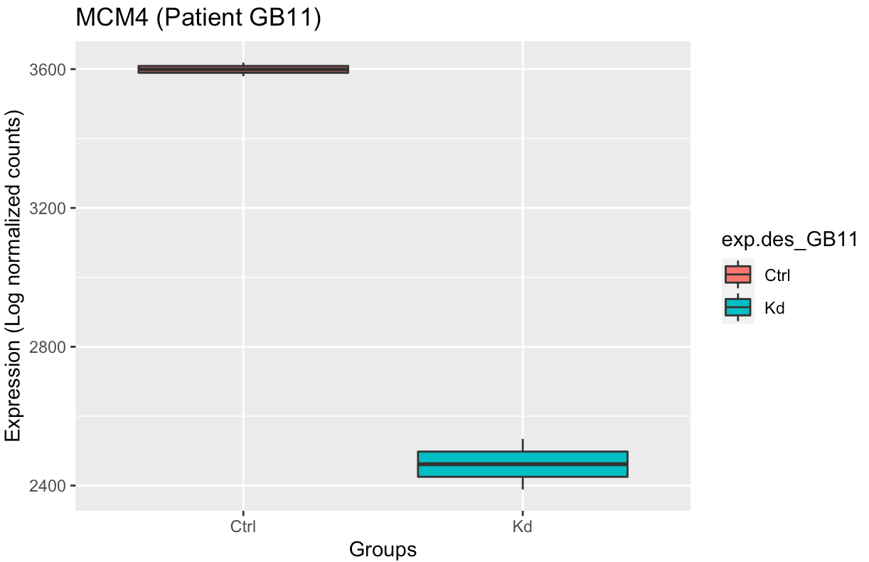

MCM4

Slide 41



MCM5

Slide 42



MCM6

Slide 43



MCM7

Slide 44



ICAM-1
Notes:
https://www.nature.com/articles/s41419-022-04862-1

Slide 45



BRAF
Notes:
https://www.nature.com/articles/s41419-022-04862-1

Slide 46



MYBL2

